Slide 1

The
Eagle gazette
june 2026

Slide 2



pRINCIPAL’S MESSAGE
Dear SKE Community,
The 25/26 school year is drawing to a close, and it is time to genuinely congratulate our learners who have worked so hard this year to build their skills, deepen their knowledge, and share in friendships. This year our educator team has focused on fostering collaboration, critical thinking and identities as writers for all of our students. We are so very proud of each individual’s progress along the way!
We are also incredibly proud of our grade 6 student cohort who are heading off to new adventures in the fall. We will miss each of them, but know they are ready to explore new pathways.
Parents & caregivers, we invite you to complete a year-end survey to help us reflect upon this past year, and to plan for next year. As well, our amazing SKE PAC has included questions to help them with their planning. Please take a few minutes to share your thoughts. Simply click the graphic on the right.
Sincerely,
Ms. Lemon

Slide 3
SHARING KINDNESS EVERYDAY!
New registration documents will be accepted until Friday, June 26th. The office reopens Monday, August 31 for late registrations.
Please register online as soon as possible at ske.sd23.bc.ca/
UPCOMING DATES
June 1-5 GoByBike Week
June 1-5 Last Week for Library
June 2 District Track Meet
June 8-12 Inline Skating- volunteer!
June 12 PAC Family Fun Night-volunteer!
June 15-17 Inline Skating-volunteer!
June 16 PAC Meeting @ 7 pm
June 21 National Indigenous Peoples Day
June 22 Play Day - volunteer here!
June 23 Grade 6 Trip to KLO
June 24 Grade 6 Recognition
June 25 Last Day for Students
June 25 Learning Updates Go Home
Written Learning Updates will be sent home on
Thursday, June 25th.
Reports may be picked up at the office in September if not taken home on that day.
THE CENTRAL OKANAGAN SCHOOL DISTRICT’S
SANCTUARY SCHOOLS POLICY
The Central Okanagan School District's Sanctuary Schools Policy
Board Policy 421 – Sanctuary Schools (see www.sd23.bc.ca) upholds the Board's commitment to providing educational opportunities for all students who are ordinarily resident in the Central Okanagan, including those with precarious immigration status or no immigration status.
Student registrations that pertain to Policy 421 – Sanctuary Schools will be processed through the Welcome Centre.

Slide 4





SUMMER SUN SAFETY
As the weather warms up, please help your child come prepared for sunny days at school. A sun hat and sunscreen applied before arriving are important, along with light, breathable clothing. Be sure to send a refillable water bottle each day to help keep them cool and hydrated. Together, we can ensure everyone stays safe and comfortable in the sun!
SKE PLAY DAY
We’re excited to announce that Play Day will take place on Monday, June 22nd! Students will enjoy a full day of outdoor activities and fun.
Please remember to send your child with:
A full lunch and plenty of snacks
A hat
Sunscreen
A water bottle
We are looking for volunteers to help run activity stations throughout the day. If you’re available, please sign up using the link provided HERE.
A big thank you to our wonderful PAC for generously covering the full cost of this
year-end Play Day!
WHEELS SAFETY
As more students bring scooters, bikes, and skateboards to school, we’d like to remind families that all wheeled equipment must be walked—not ridden—on school grounds. Helmets are mandatory for all riders.
Thank you for helping us keep our school community safe and
moving responsibly.
SAFETY FIRST

Slide 5


As we get ready for GoByBike week, we want to ensure our families have accurate information regarding e-scooters and e-bikes.
Please check out the poster on the left.
Upon review, you will note that no students at SKE are legally old enough to use this equipment, so it should not come to school.

Slide 6



go by bike
week june 1 -5
South Kelowna Elementary is celebrating GoByBike Week!
Together with many other schools in BC, June 1st to 5th, 2026, SKE is celebrating GoByBikeWeek and encourages students and their families, as well as teachers and staff members, to ride their bikes whenever they can: to and from school, or before and after school, as well as on the weekends.
Rolling around on smaller wheels like scooters and rollerblades counts, too...however, please walk all "wheel" items on school property. By riding their bike, students will spend time outside and get exercise, breathe fresh air, arrive energized at school, and reduce traffic in and around the school's neighbourhood at the same time.
Less traffic means more safety for cyclists. More safety means more fun. More fun means natural behavioural change towards a sustainable future. Riding bikes is fun and helps the environment.
Mark your calendars and GoByBike June 1st to 5th.

Slide 7


F
PAC FAMILY FUN NIGHT
We’re excited to invite families to our upcoming Family Fun Night at SKE—an evening of games, food, and fun for all ages! $2 entry!
To make this event a success, we’re looking for volunteers. Whether you can help with setup, run a game station, or assist with cleanup, your support is greatly appreciated.
CLICK HERE TO SIGN UP AND GET INVOLVED!
Do you want a table at the Marketplace? Contact Jenny @ kurnikjenny0@gmail.com!
As we prepare for Family Fun Night, we'd like to extend a special thank you to a local massage therapist, Maureen O'Reilly- RMT who has generously donated a complimentary massage gift certificate for our raffle.
We are so grateful for the support of local businesses that help make events like Family Fun Night possible. As a thank you, we've attached her flyer so families can learn more about her services. It's wonderful to have a wellness practitioner located right here in our neighbourhood, just around the corner from the school.

Slide 8

2026-2027 SCHOOL ORGANIZATION
The staff for 2026-2027 are listed below. This list is subject to change.
As in every year, teaching assignments and class organizations are subject to change in the fall. If you are moving over the summer and/or your children will not be attending SKE in the fall, please let the office know ASAP.
There are many factors that go into building balanced classes and we ask that parents trust the decisions that we make. Careful consideration and collaboration are always present during this process, in regards to meeting students’ learning needs.
PRINCIPAL: Ms. Jasmine Lemon
Adminstrative Assistant: Ms. Kristy Angus
Library/Office Assistant: Mrs. Angela MacLean
Kindergarten: Ms. Robertson, Ms. Romano
Primary: Mrs. Oakes, Mrs. Jennejohn, Mrs. Shanks
Intermediate: Mrs. Shannon, Mrs. Bernard, Ms. Tse-Klassen, Mrs. Morgan, Ms. Wilson
Teacher Librarian: Mrs. Obedkoff
Arts Education: To Be Determined
Learning Assistance: Mrs. Bitcon
Inclusion Teacher: Mrs. Lindsay
Speech & Language: To Be Determined
Indigenous Advocate: Ms. Phillips
Counsellor: To Be Determined
CEAs: Mrs. Anderson, Mrs. Brazeau, Mrs. Porritt, Ms. Crane, Mrs. Dacosta, Ms. Weselake
The first day back to school is a half day on Tuesday, September 8th. Busses will be running and students will be dismissed at 11:00 am.
All “new” to SKE Grade 1-6 students will meet in our foyer at 8:30 a.m. on September 8th. Following a brief orientation and school tour, all new students will be placed into age-appropriate, temporary classrooms. All returning students will report to their last year’s classroom.
Regular school hours (8:30-2:30) commence on September 9th for Grades 1-6. Please watch for more start up information coming for the kindergarten classes.

Slide 9

IMPORTANT DATES
  June 1-5: Last Week of Book Exchanges
LIBRARY REMINDERS
  June 11: All Books are Due
Please ensure that all reusable bags are also returned too.
Please check backpacks for overdue notices
REMINDER:
Overdue books do follow students to middle school.

Slide 10
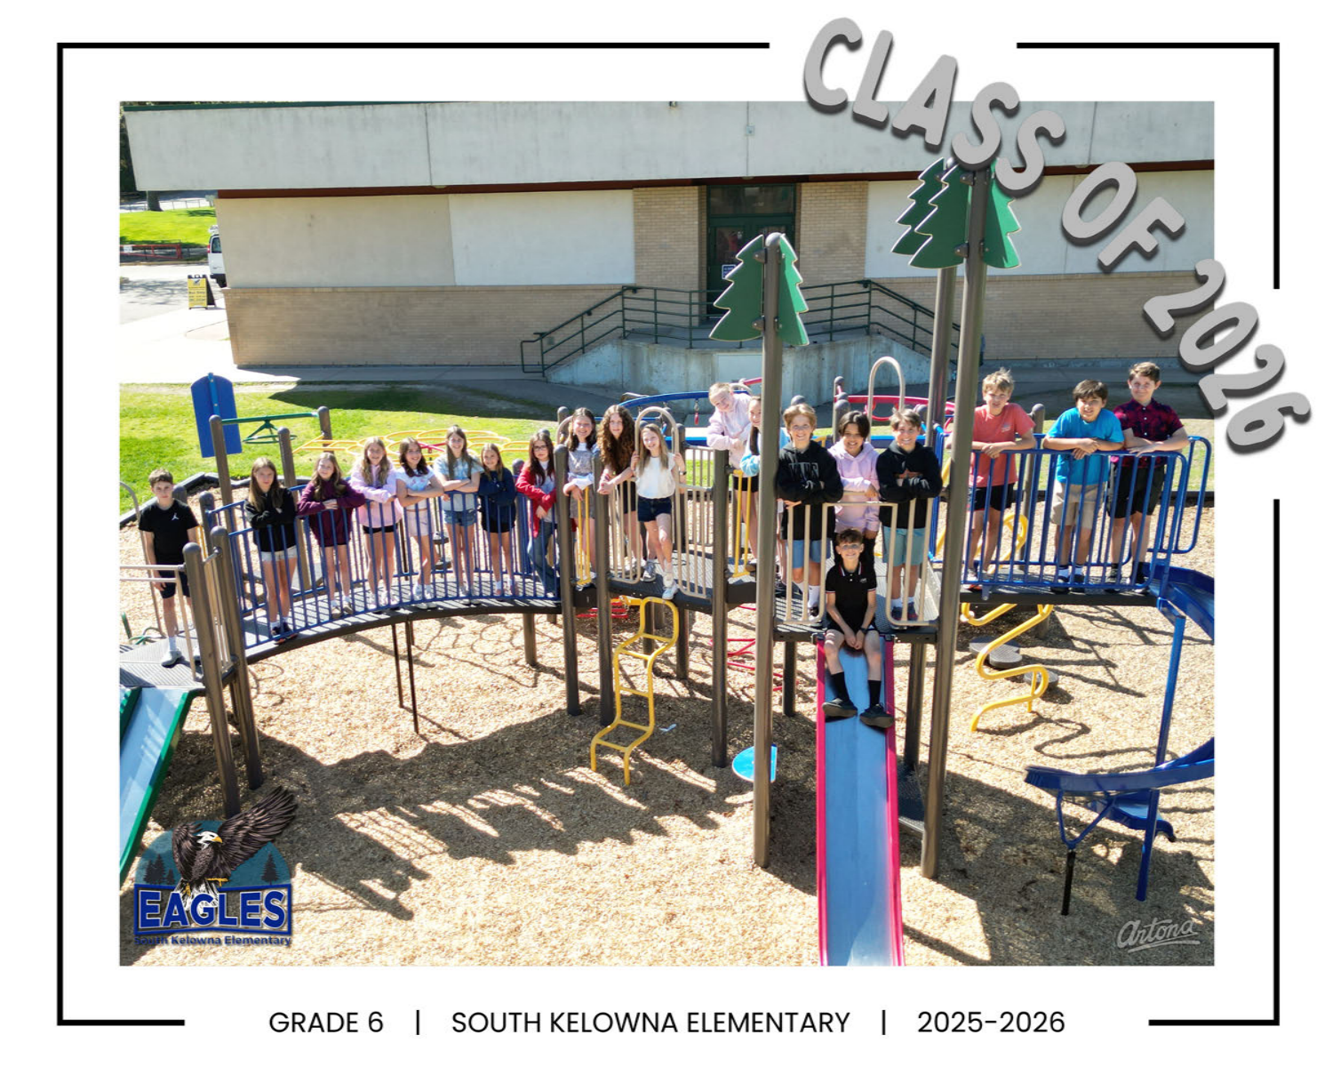

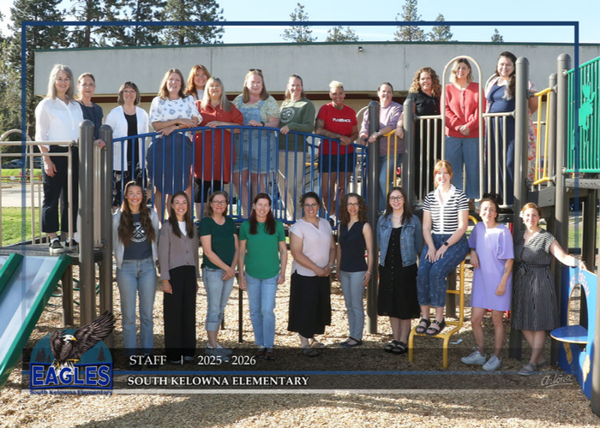
GRADE 6 GRAD
A heartfelt thank you to Mrs. Morgan, Mrs. Wilson, Ms. Brazeau and Mrs. DaCosta for fostering such a caring community and making this year truly special for our Grade 6 students.
We also extend our sincere appreciation to all the parent volunteers whose support helped make the Grade 6 experience so memorable.
We wish our graduating students all the best and hope they carry many wonderful SKE memories with them as they begin their next journey!
We look forward to celebrating our Grade 6 students at their Recognition Ceremony on Wednesday, June 24th at 1:00 PM
Families are warmly welcomed to join us as we recognize this important milestone and celebrate our students’ achievements together.
PLEASE RSVP HERE
Following the ceremony, Grade 6 students will enjoy cupcakes, while coffee and refreshments will be available for family members. We hope you can join us for this special afternoon!
STAFF PIC

Slide 11


FAREWELL AND GOOD LUCK
As the school year comes to a close, we bid farewell to several valued staff members listed below who have been an important part of our school community.
Candice DeShane
Kelsey Slattery
Nicholle Thom
Their dedication, support, and positive contributions have left a lasting impact on students and colleagues alike. We thank them for their service and wish them every success and happiness in their future endeavors. They will always remain part of our school family.
We are excited to welcome the following new staff member to the SKE community this year!
Ms. Tse-Klassen
We are grateful to have such a talented and caring individual joining our team, and we know she will make a positive impact in our school. Please join us in giving her a warm SKE welcome as she begins this new journey with us. We look forward to a wonderful year of learning, growth, and connection together!

Slide 12


PAC NEWS
The SKE PAC requires a COPAC representative. While they need to have one person formally listed as the rep, it can also be shared between several people. Without this role filled, our PAC cannot officially operate. Please contact ske.PacPresident@sd23.bc.ca for more info.
Wow! Our Hot Lunch program volunteers donated 400 hours of service this year! It also supported 16 local businesses over 98 different lunch days!
President | Kay Bowering
Vice President | Kevin Bowering
Treasurer | Blair Crosby
Secretary | JE
COPAC Representative | Can this be you?
Communications Coordinator | Jessica Blissett
Health & Safety Representative
Food Program Coordinator | Amanda Stevens & Carleigh Peach
Fundraising Coordinators | Tara Hubbard
Fruit & Veggie Program Coordinator | Kamal Gill
Green Initiative Coordinator | Ruth King
KLO Representative
Members at Large | Interested?
pAC EXECUTIVE 2026-2027

Slide 13
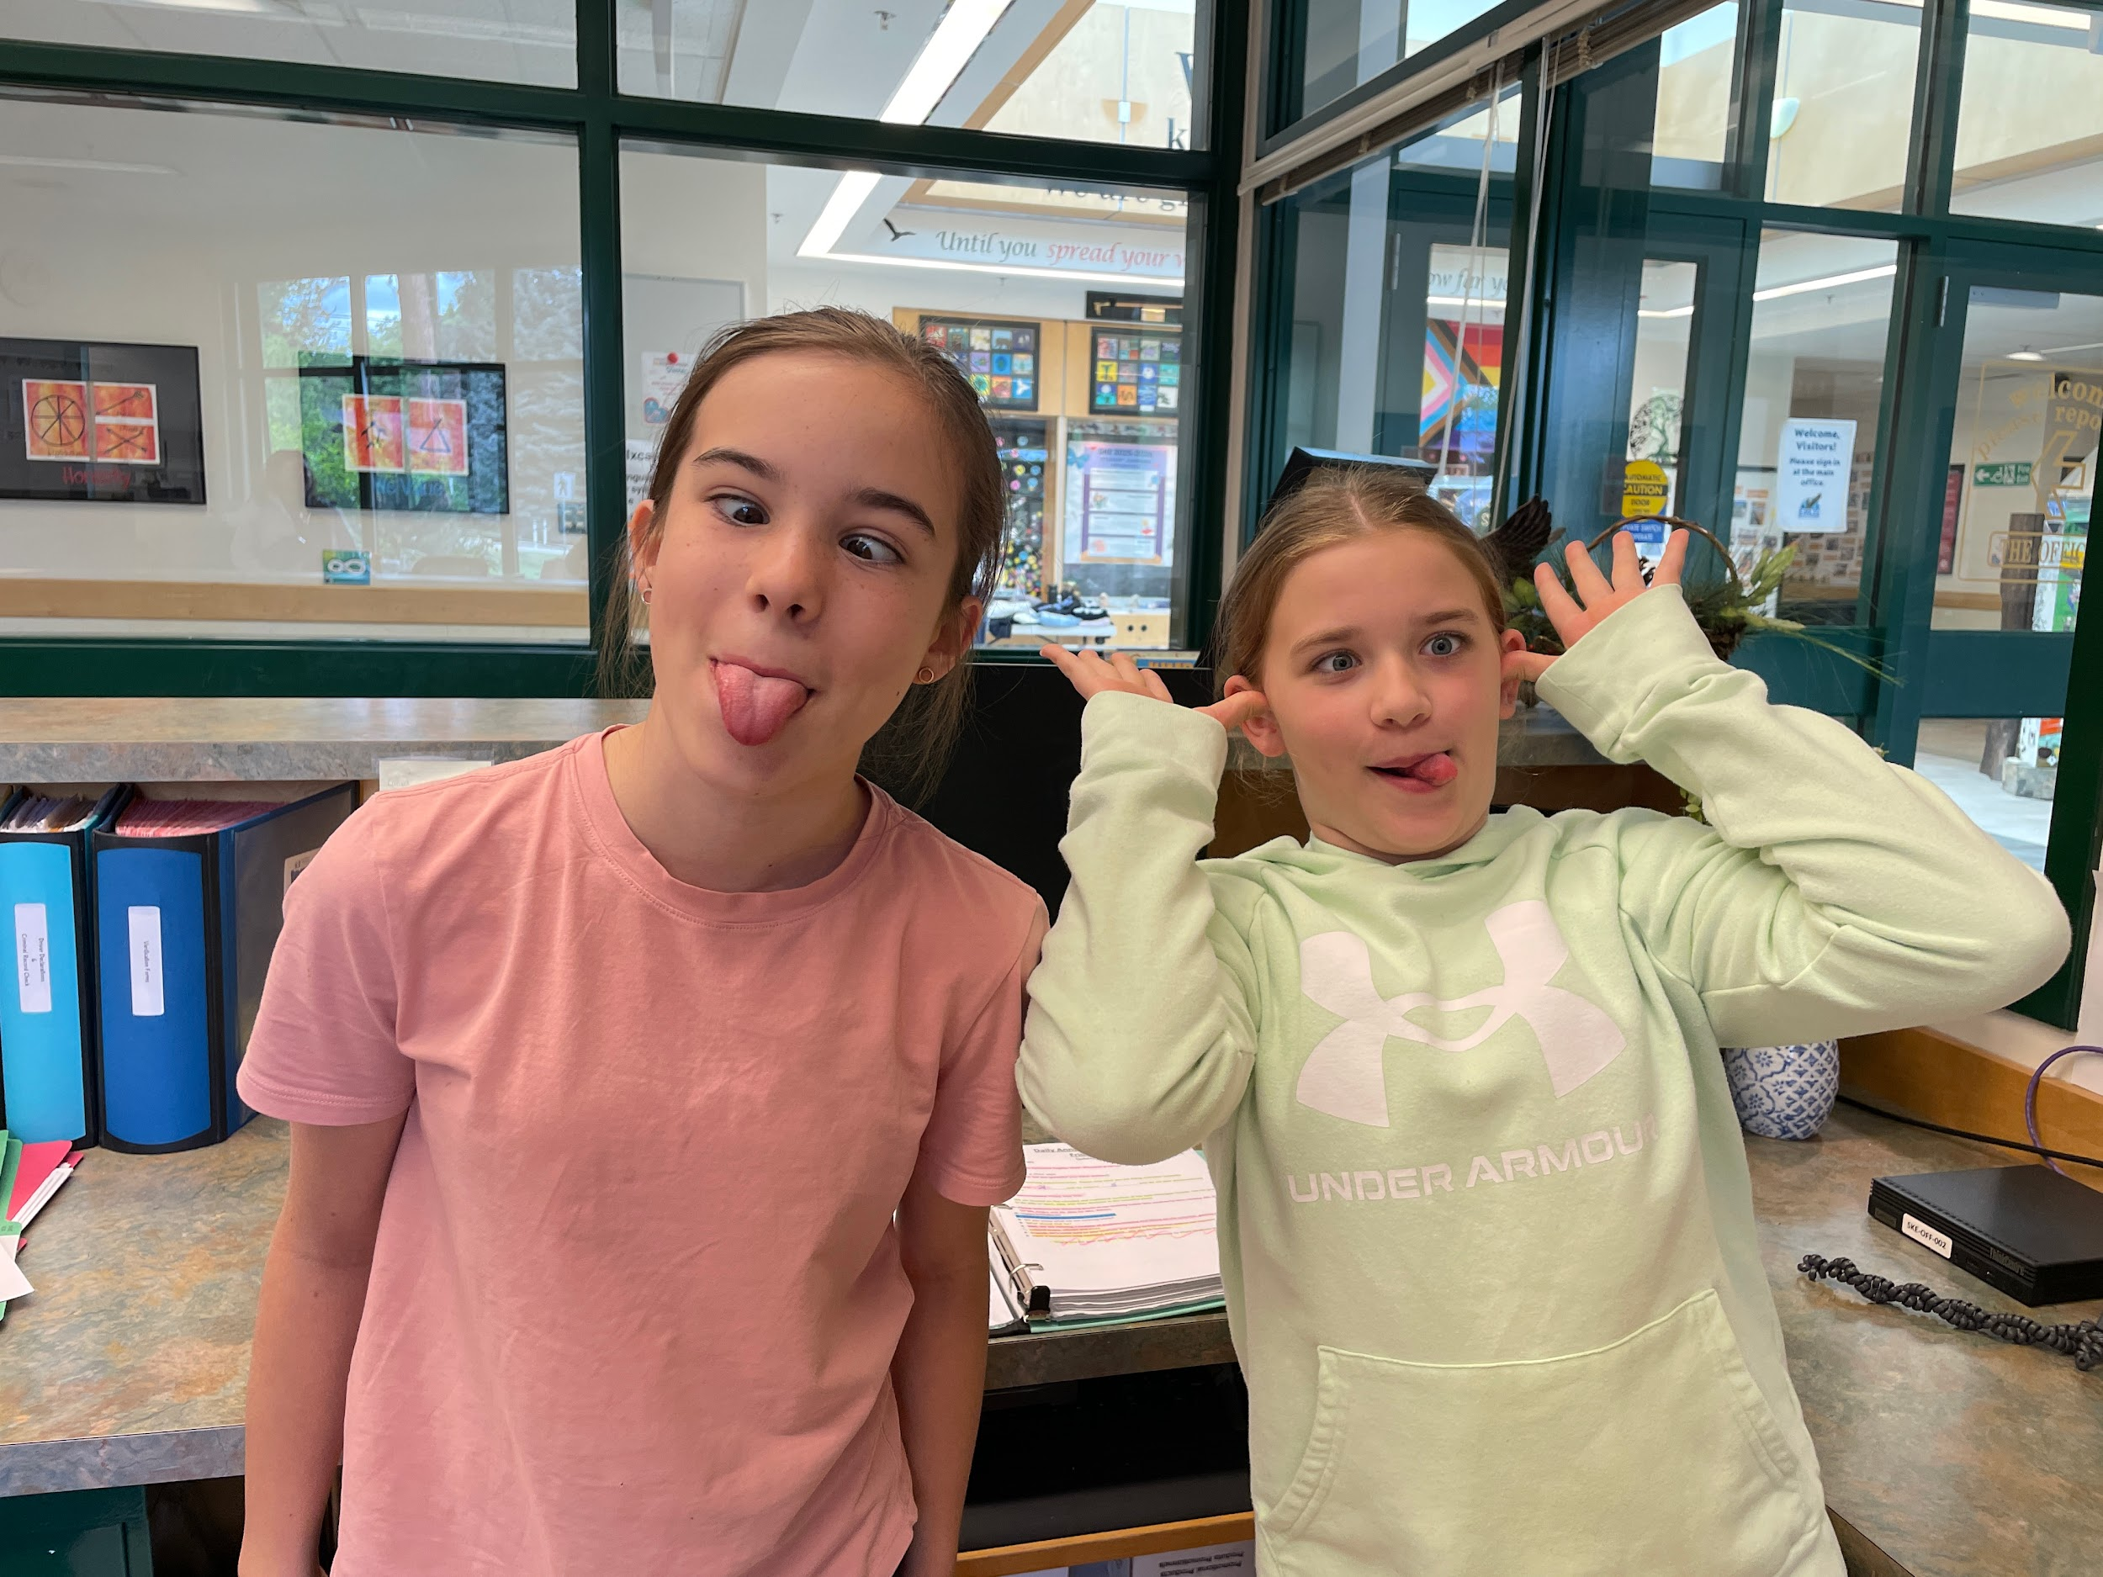
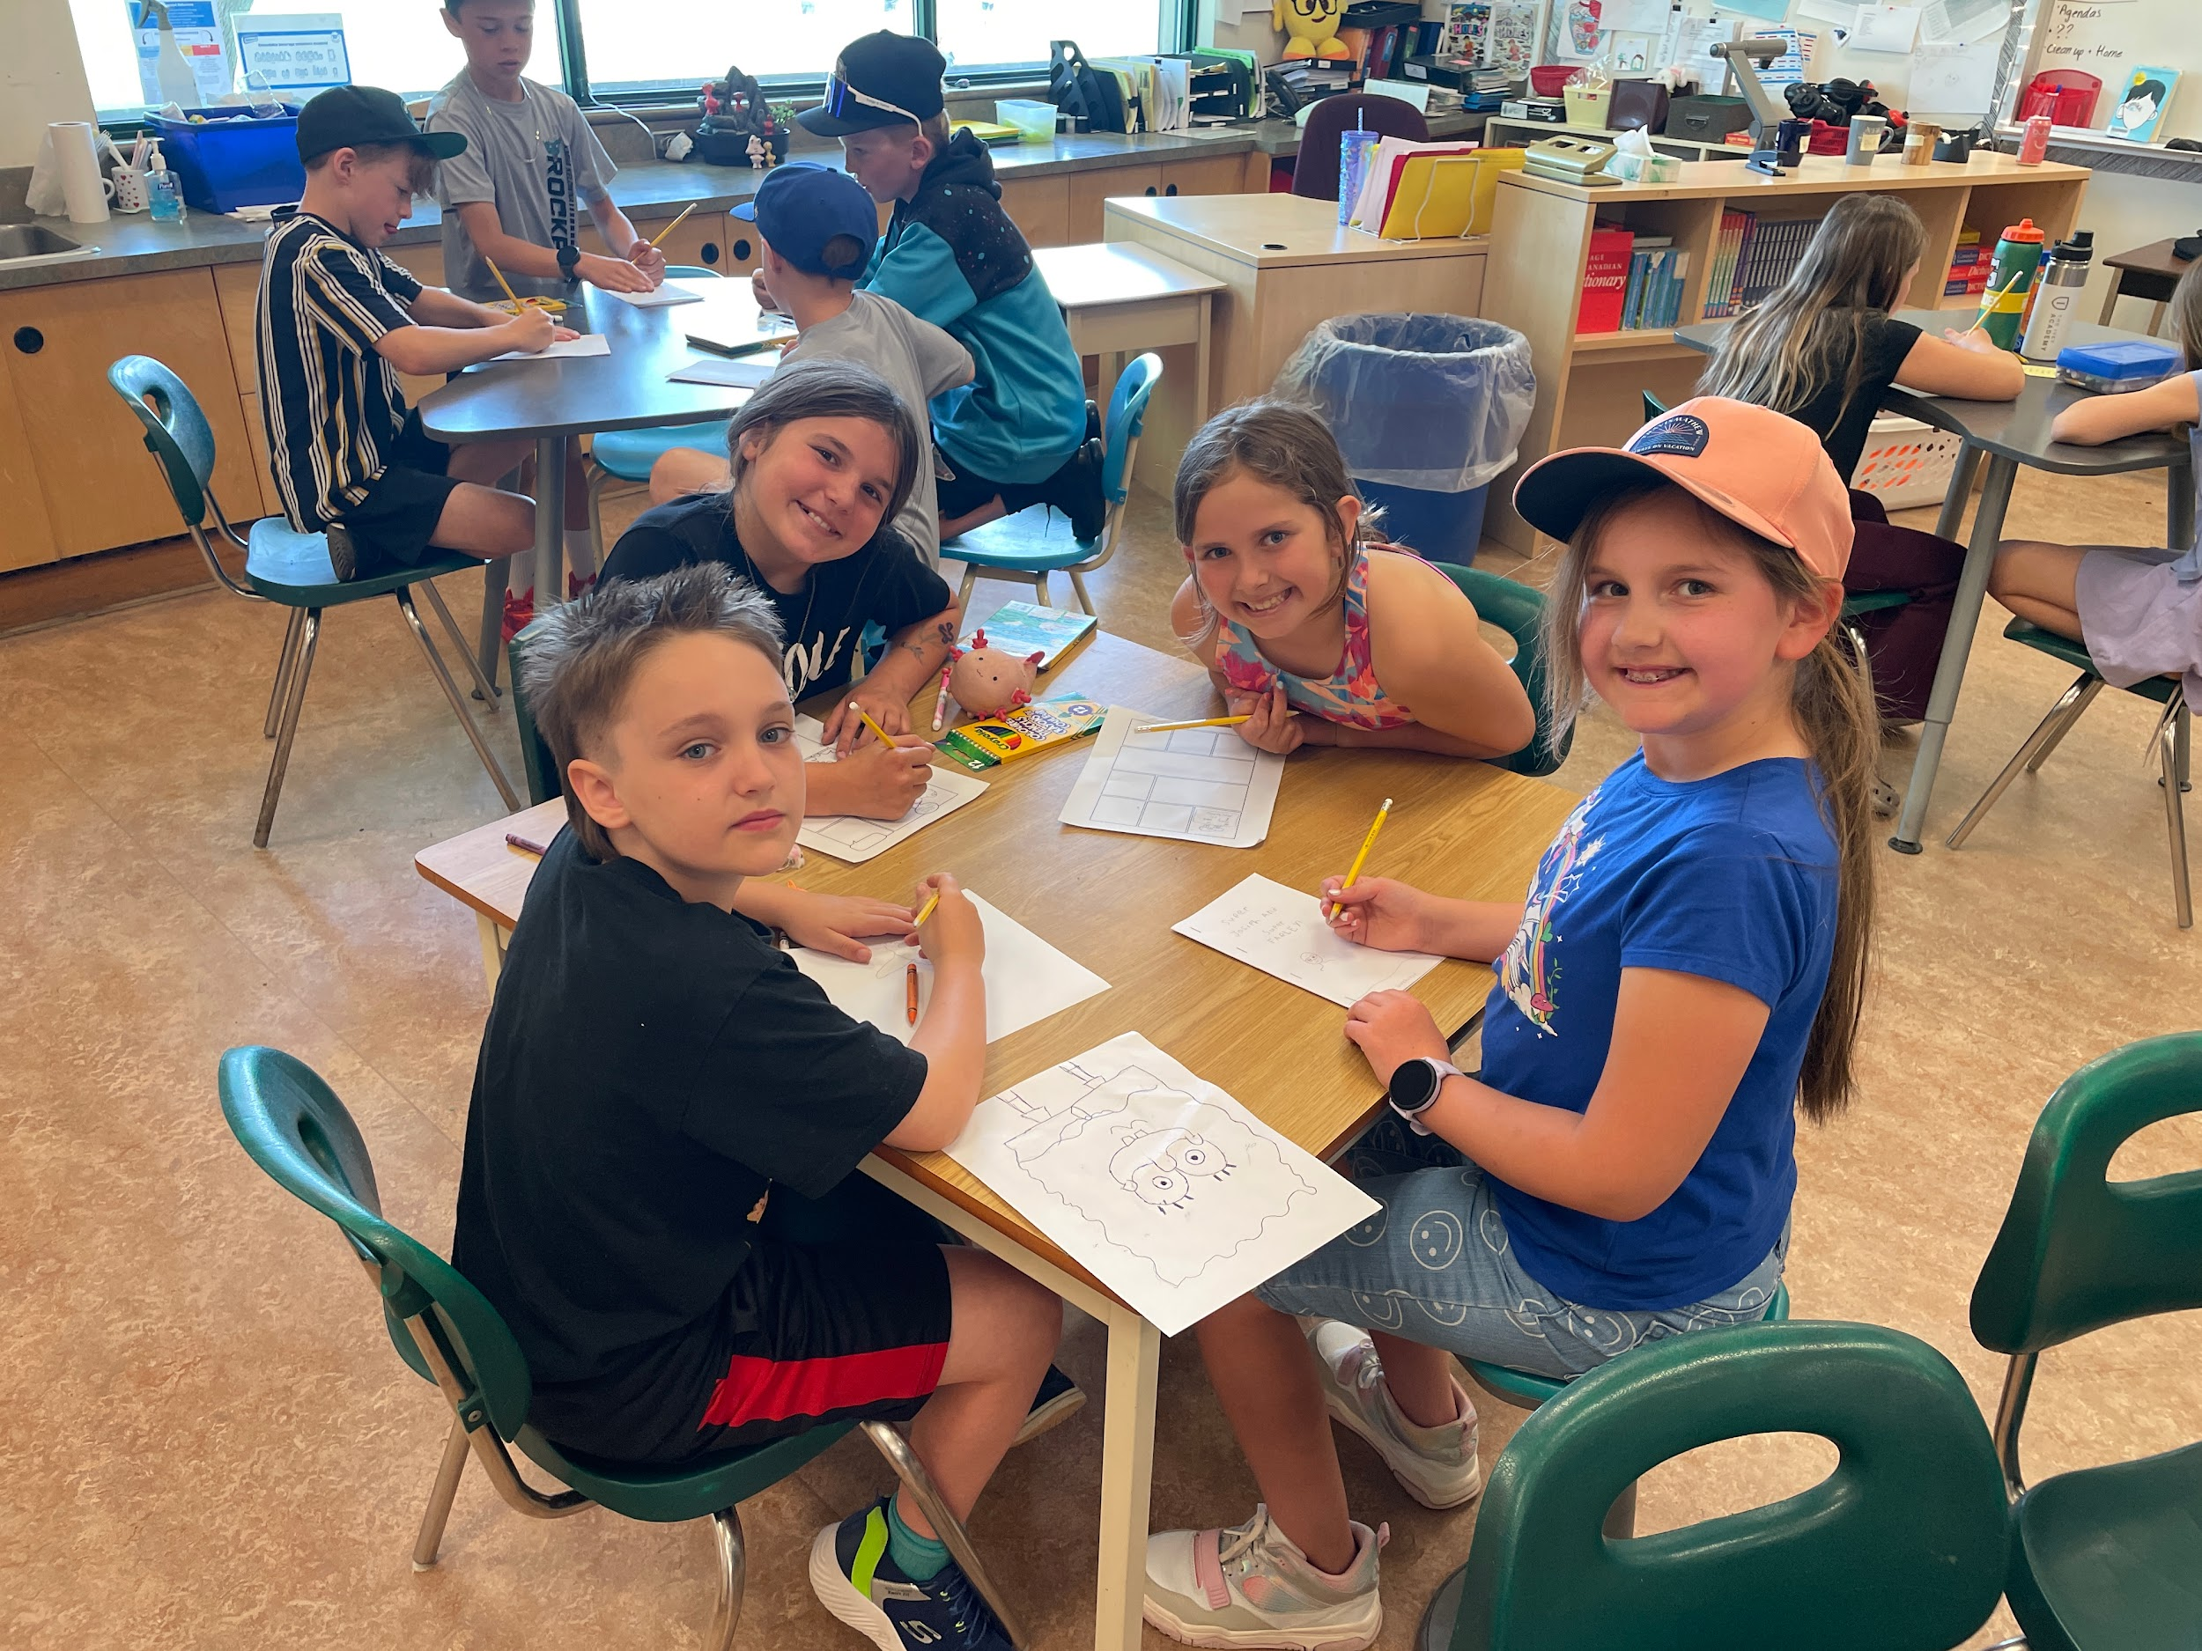
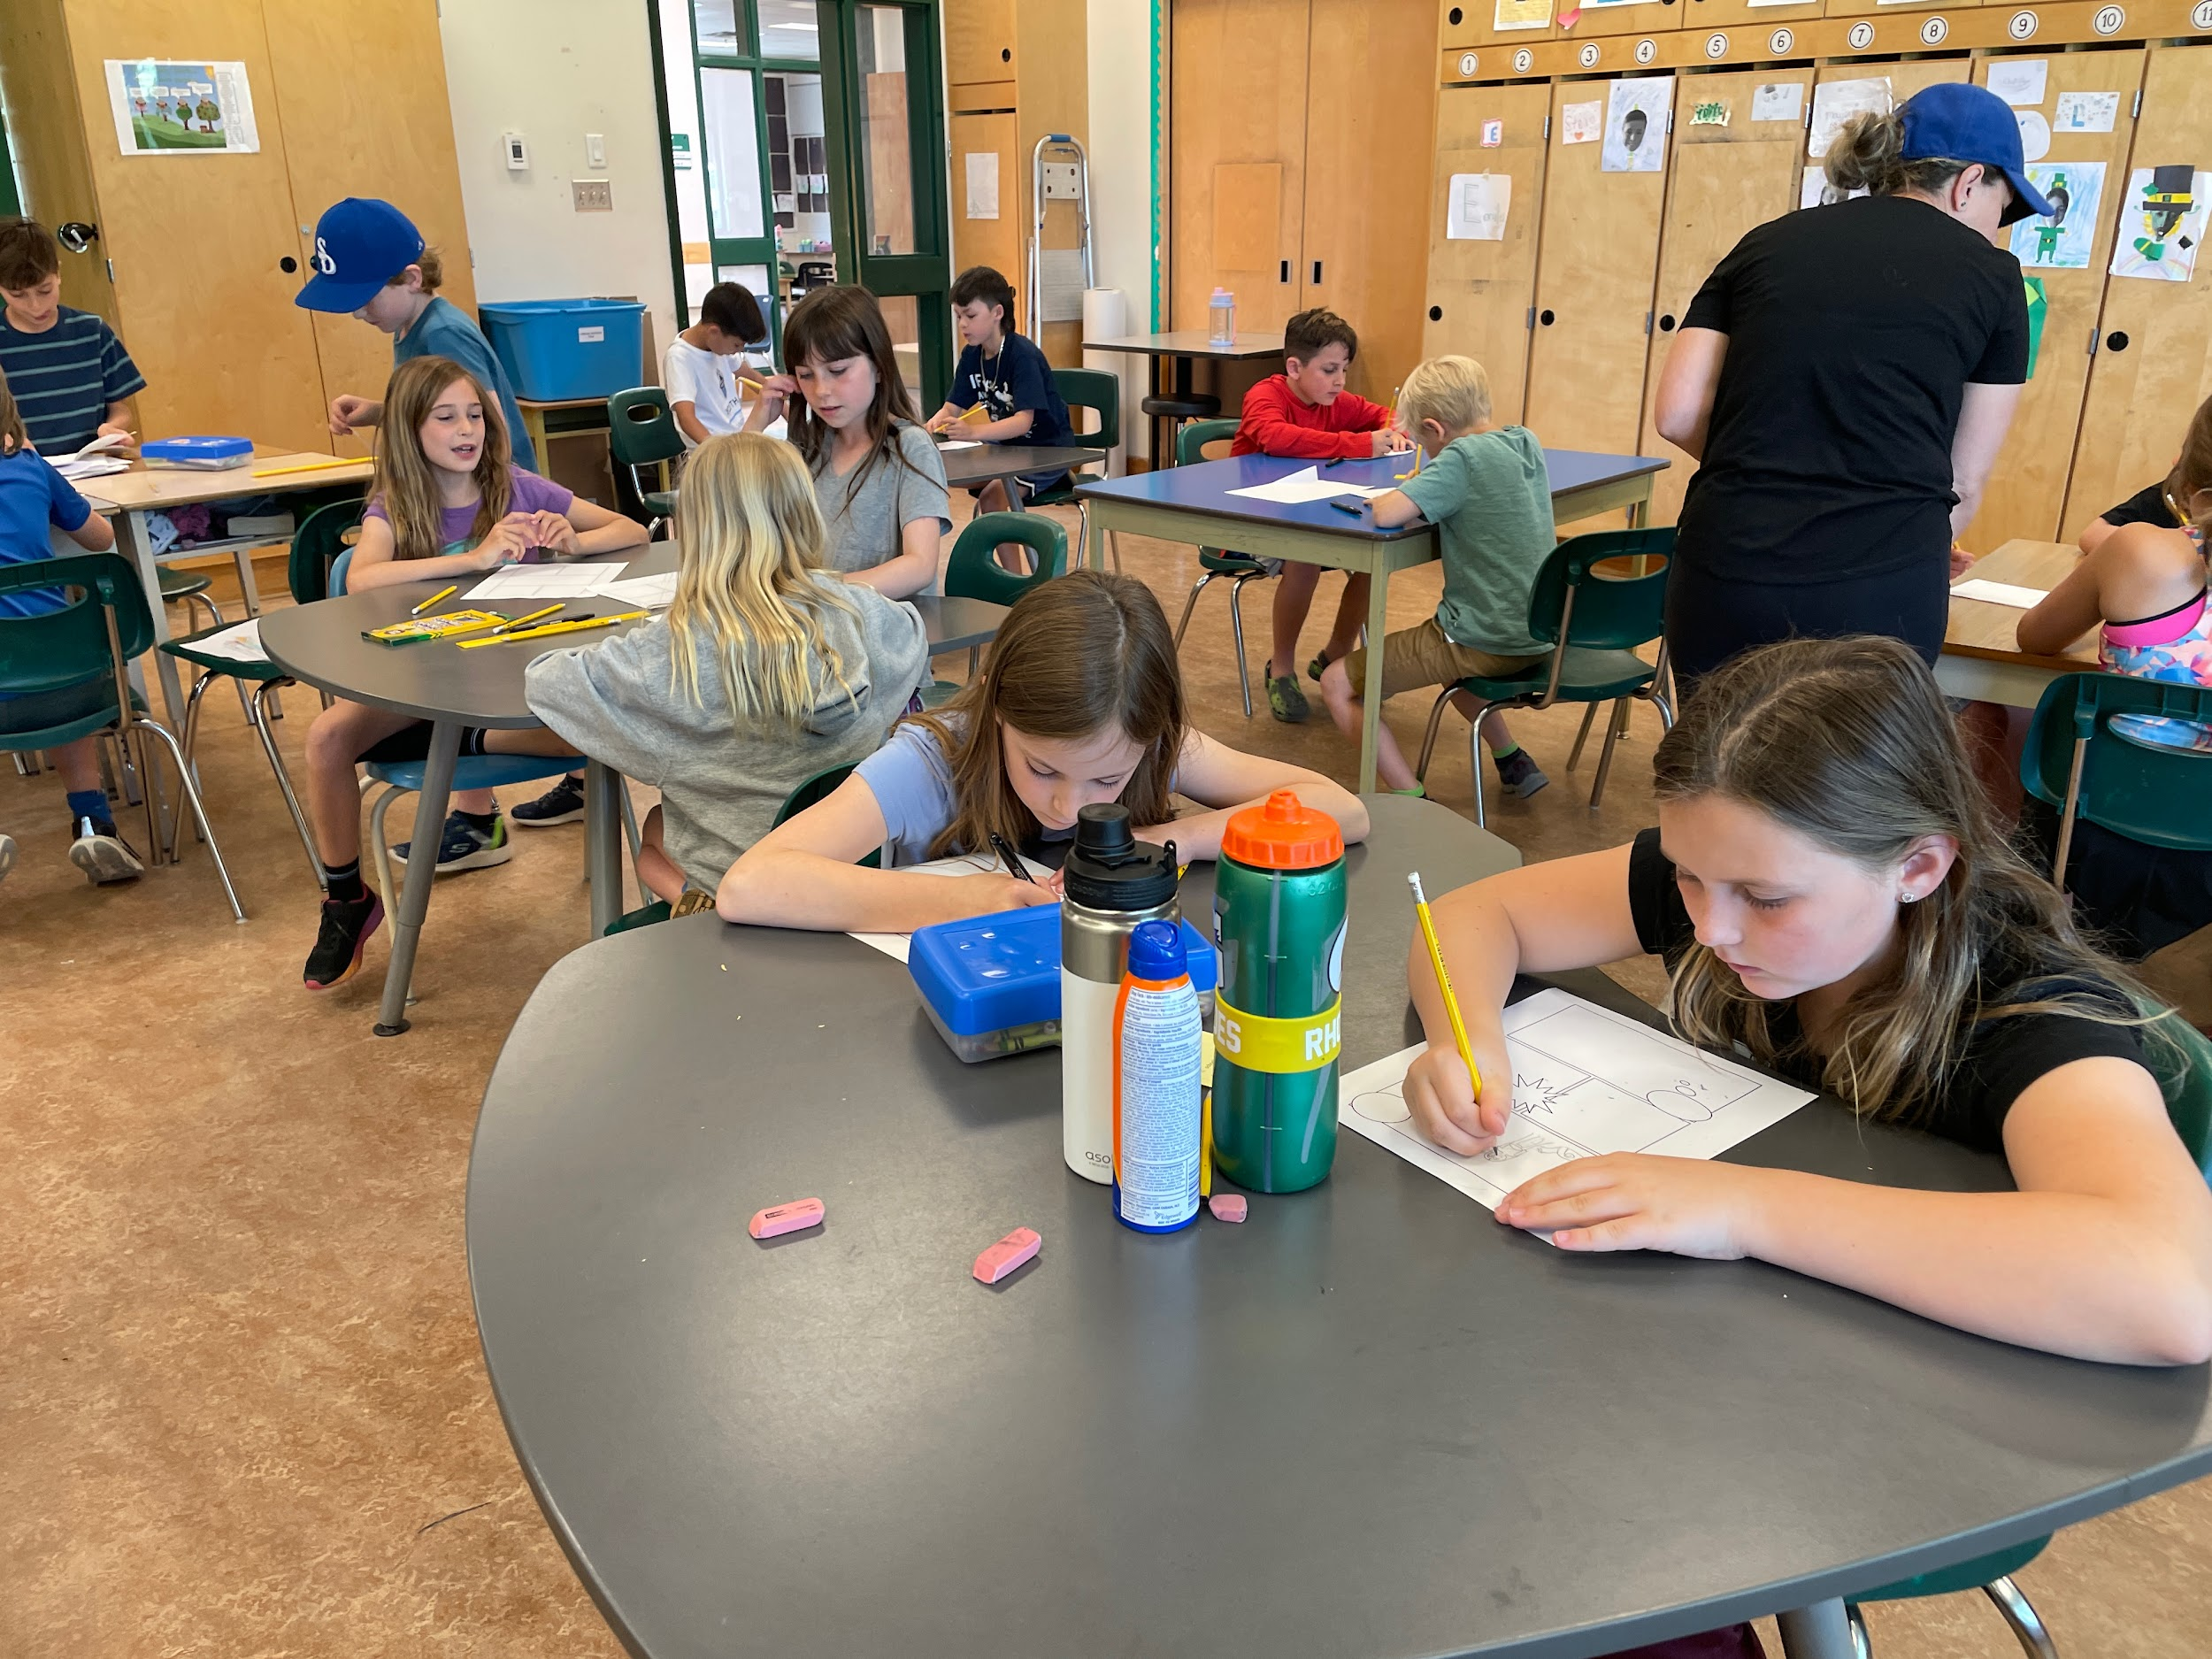
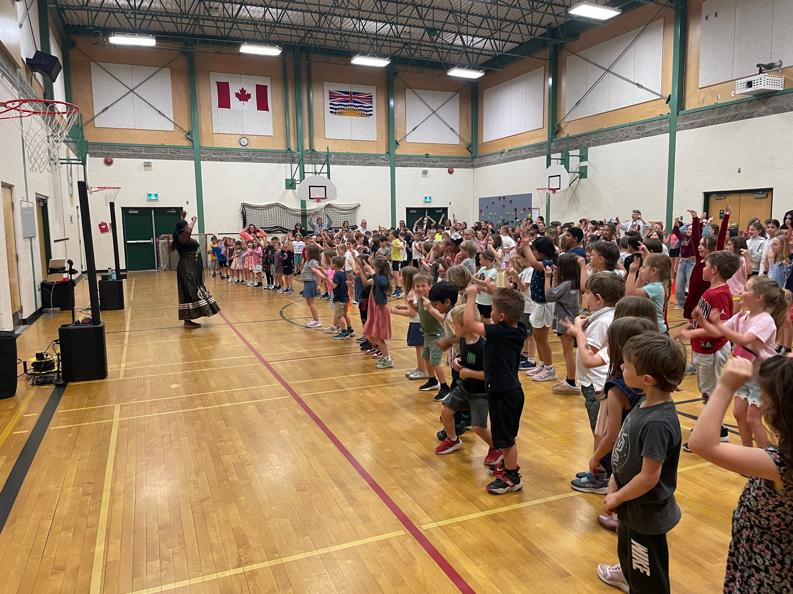
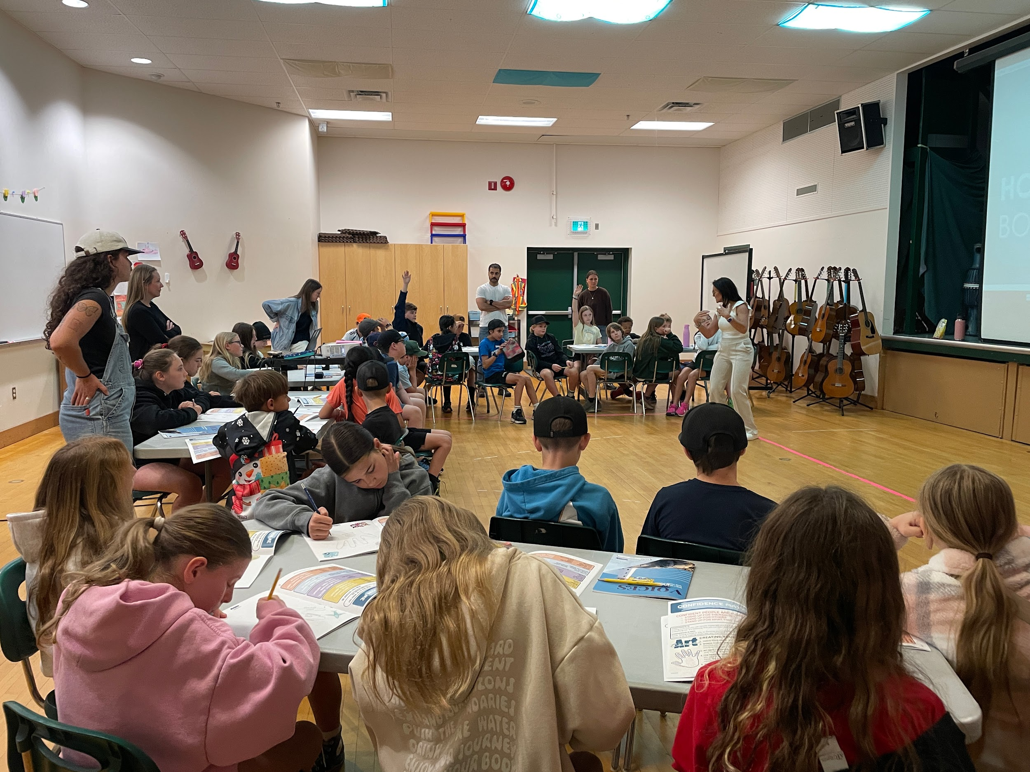
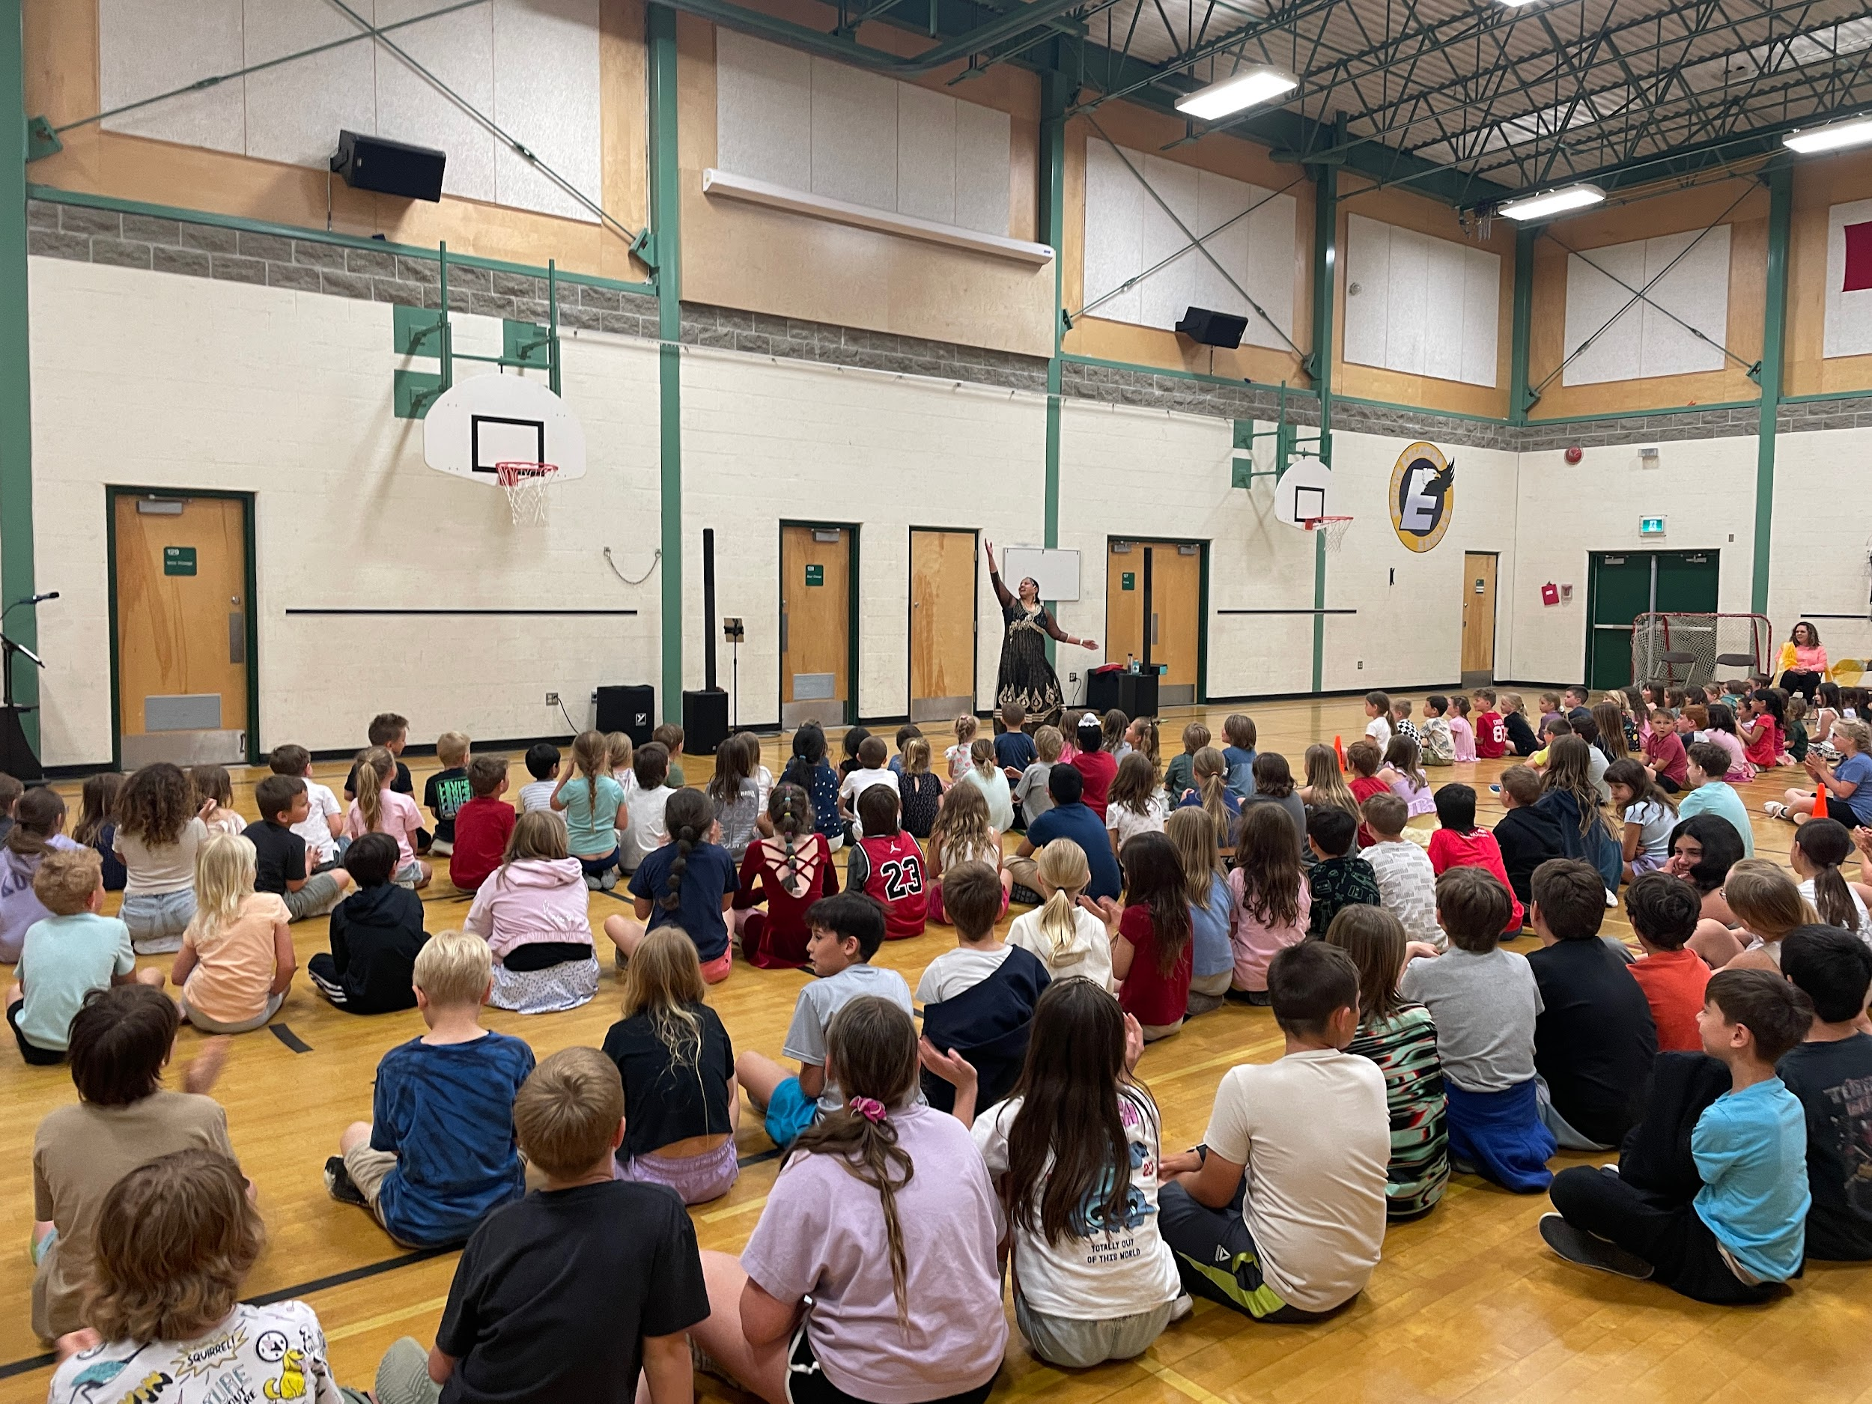
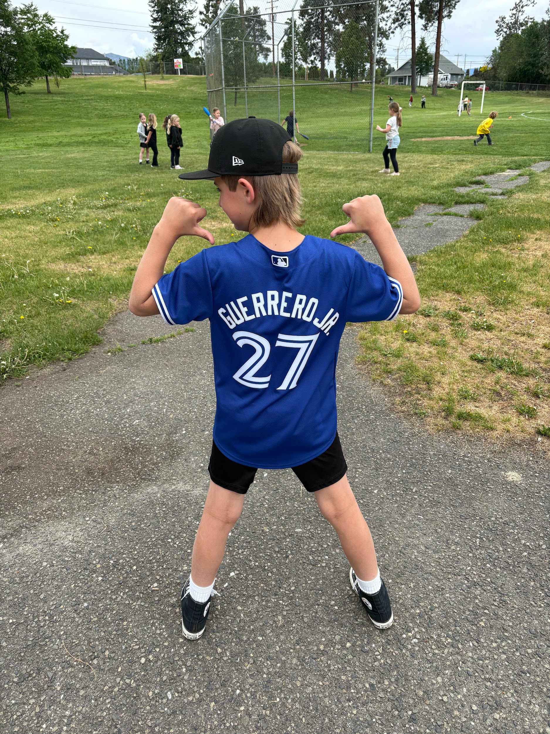
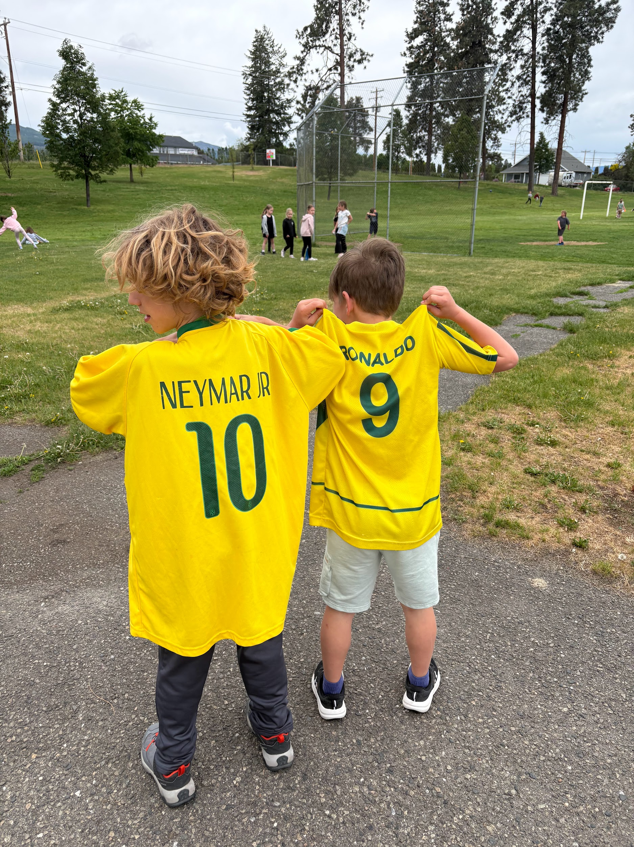
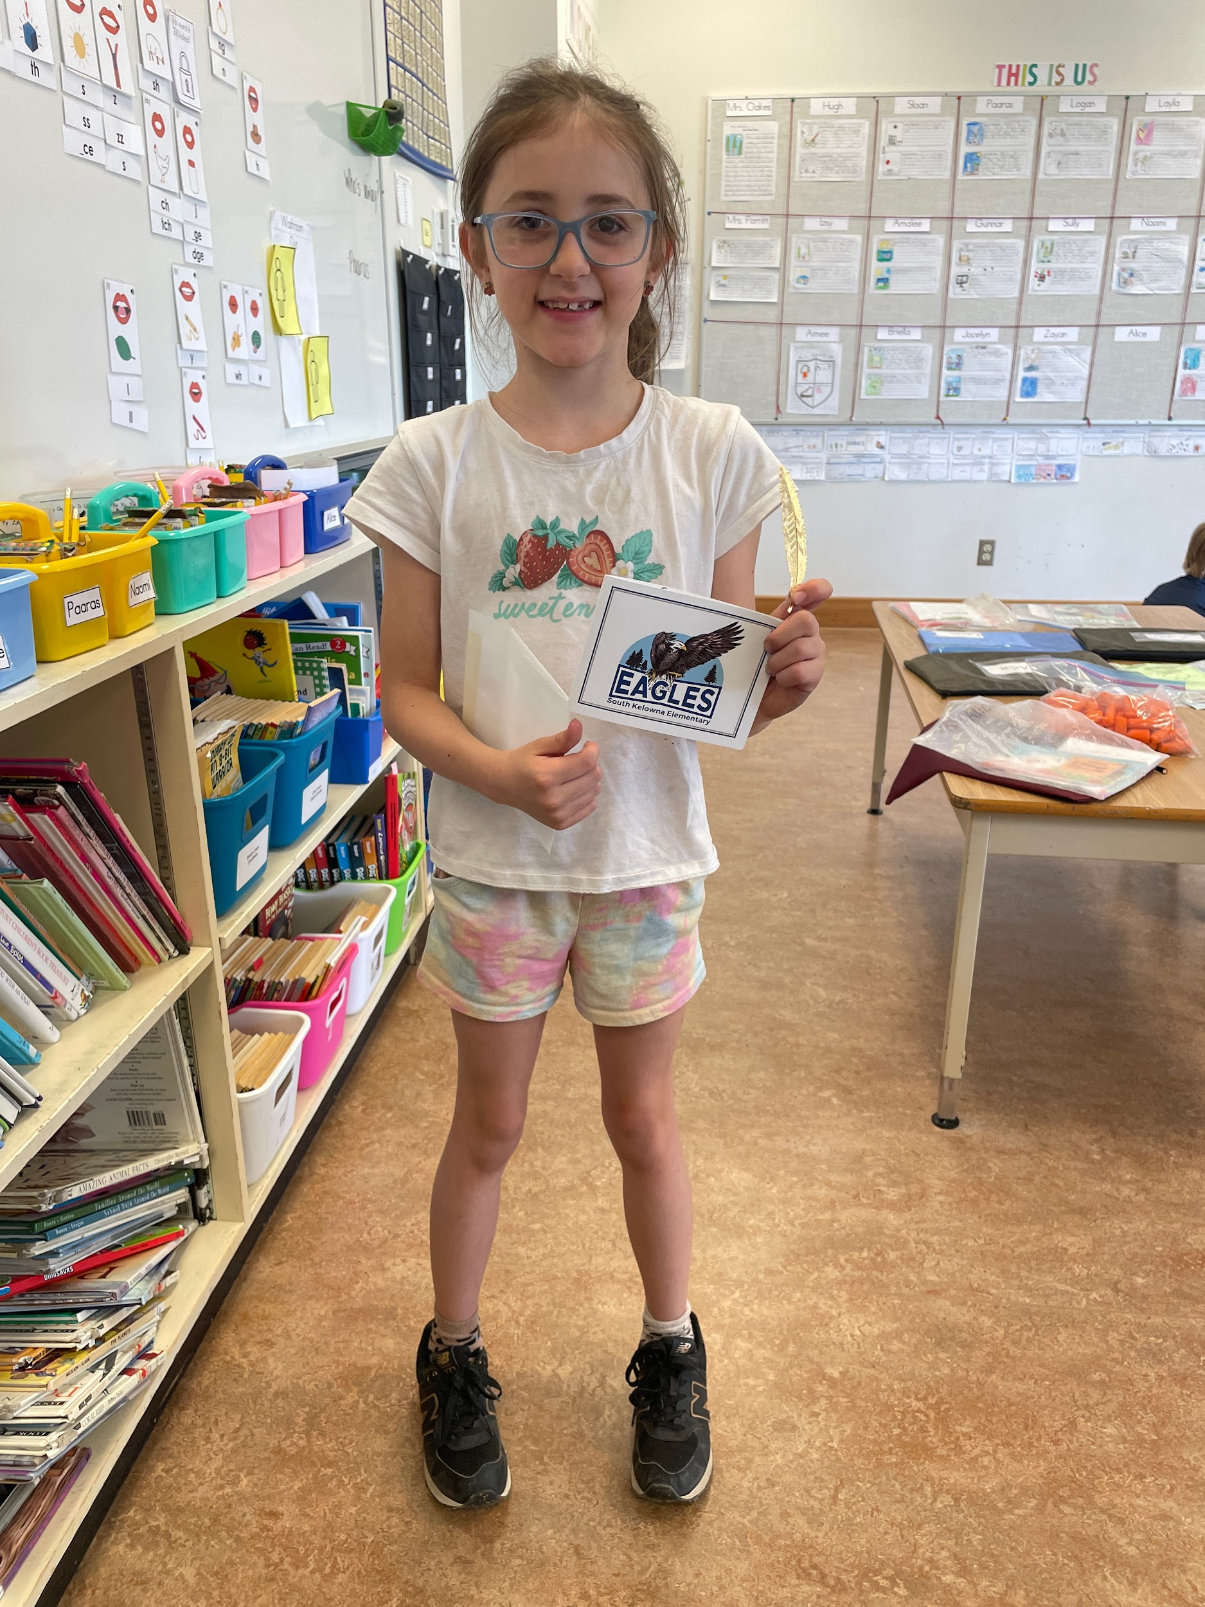
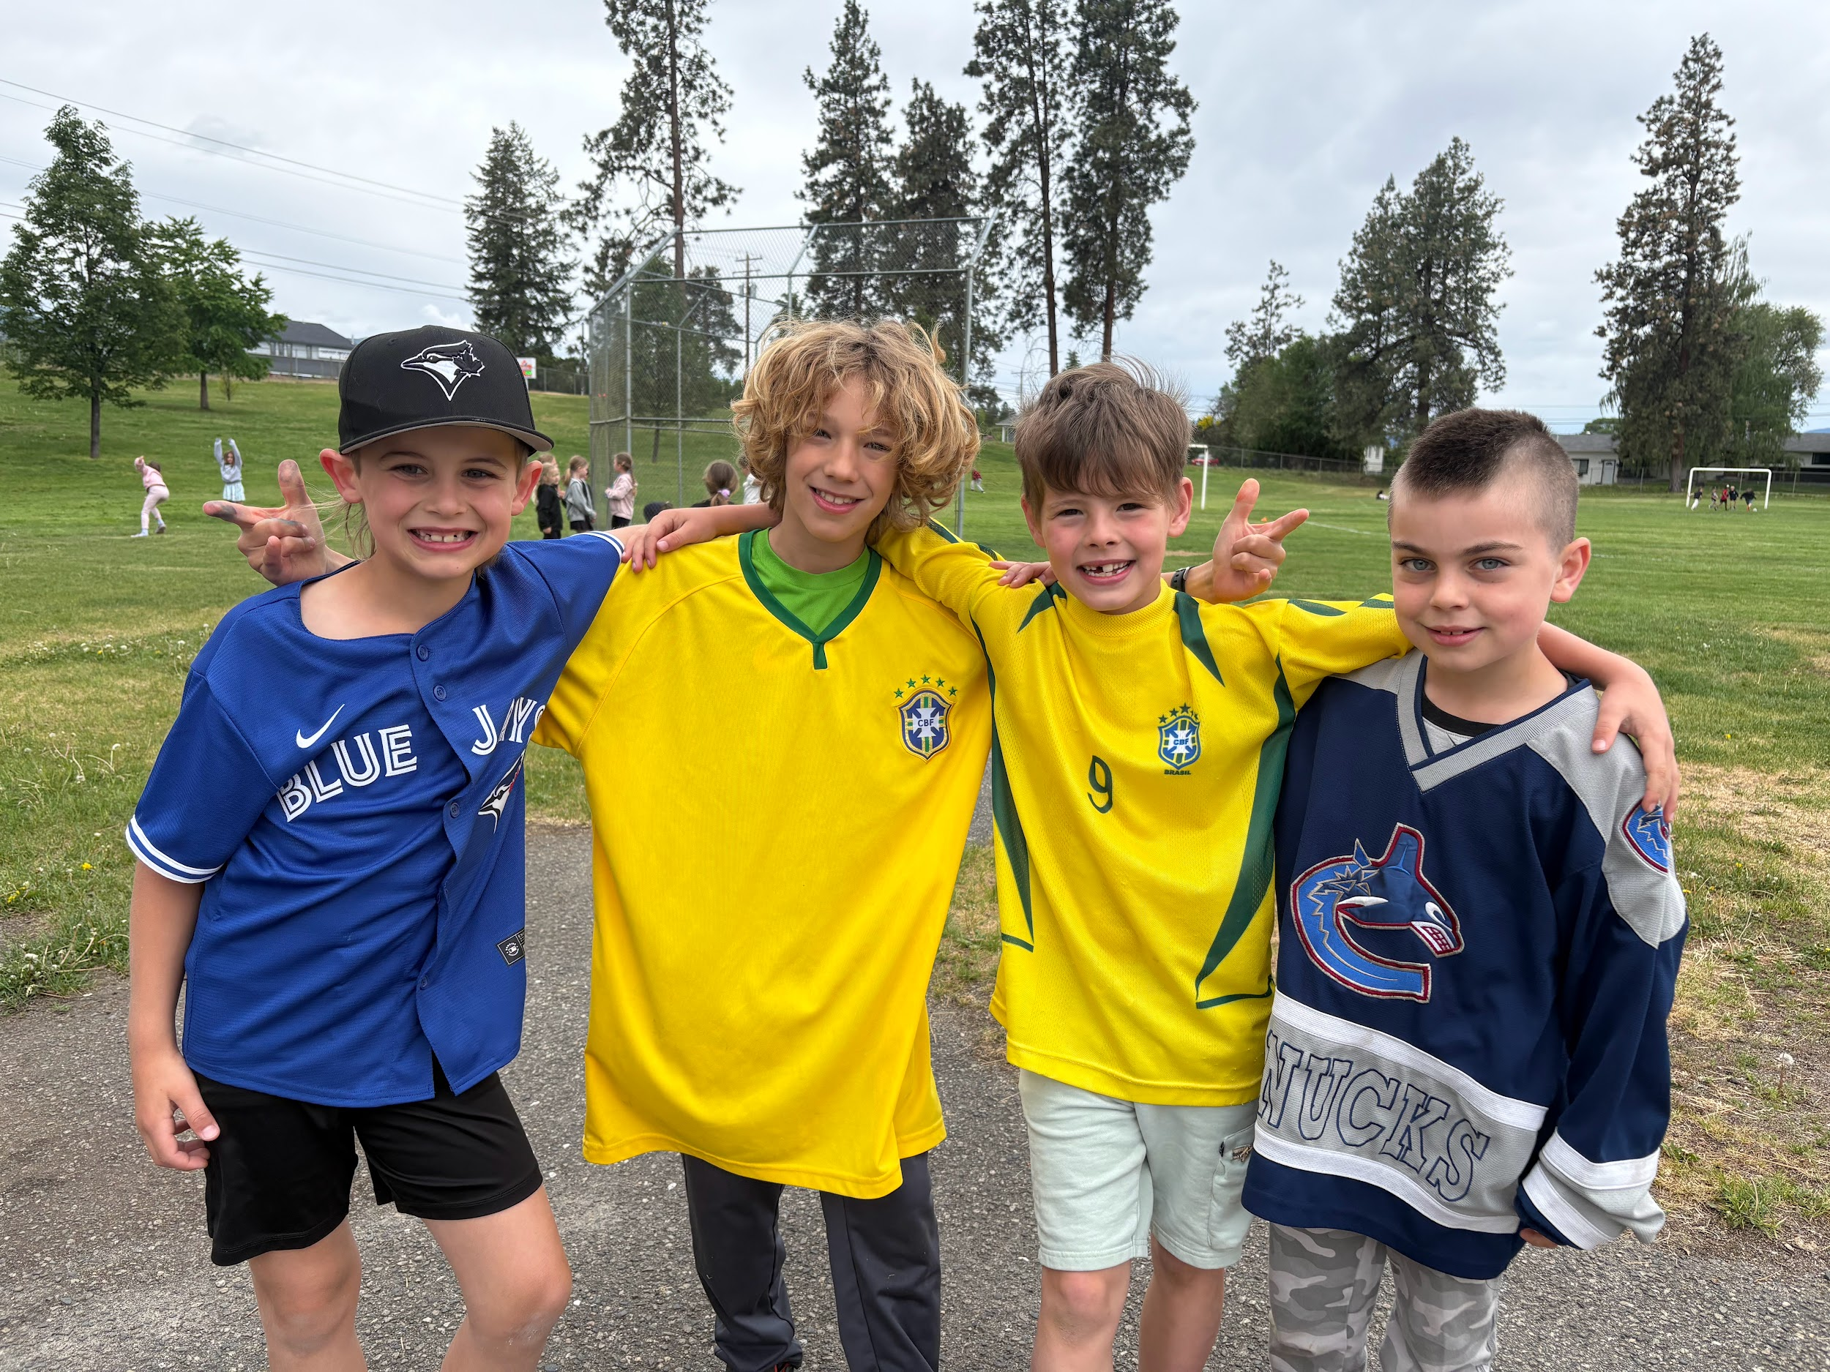
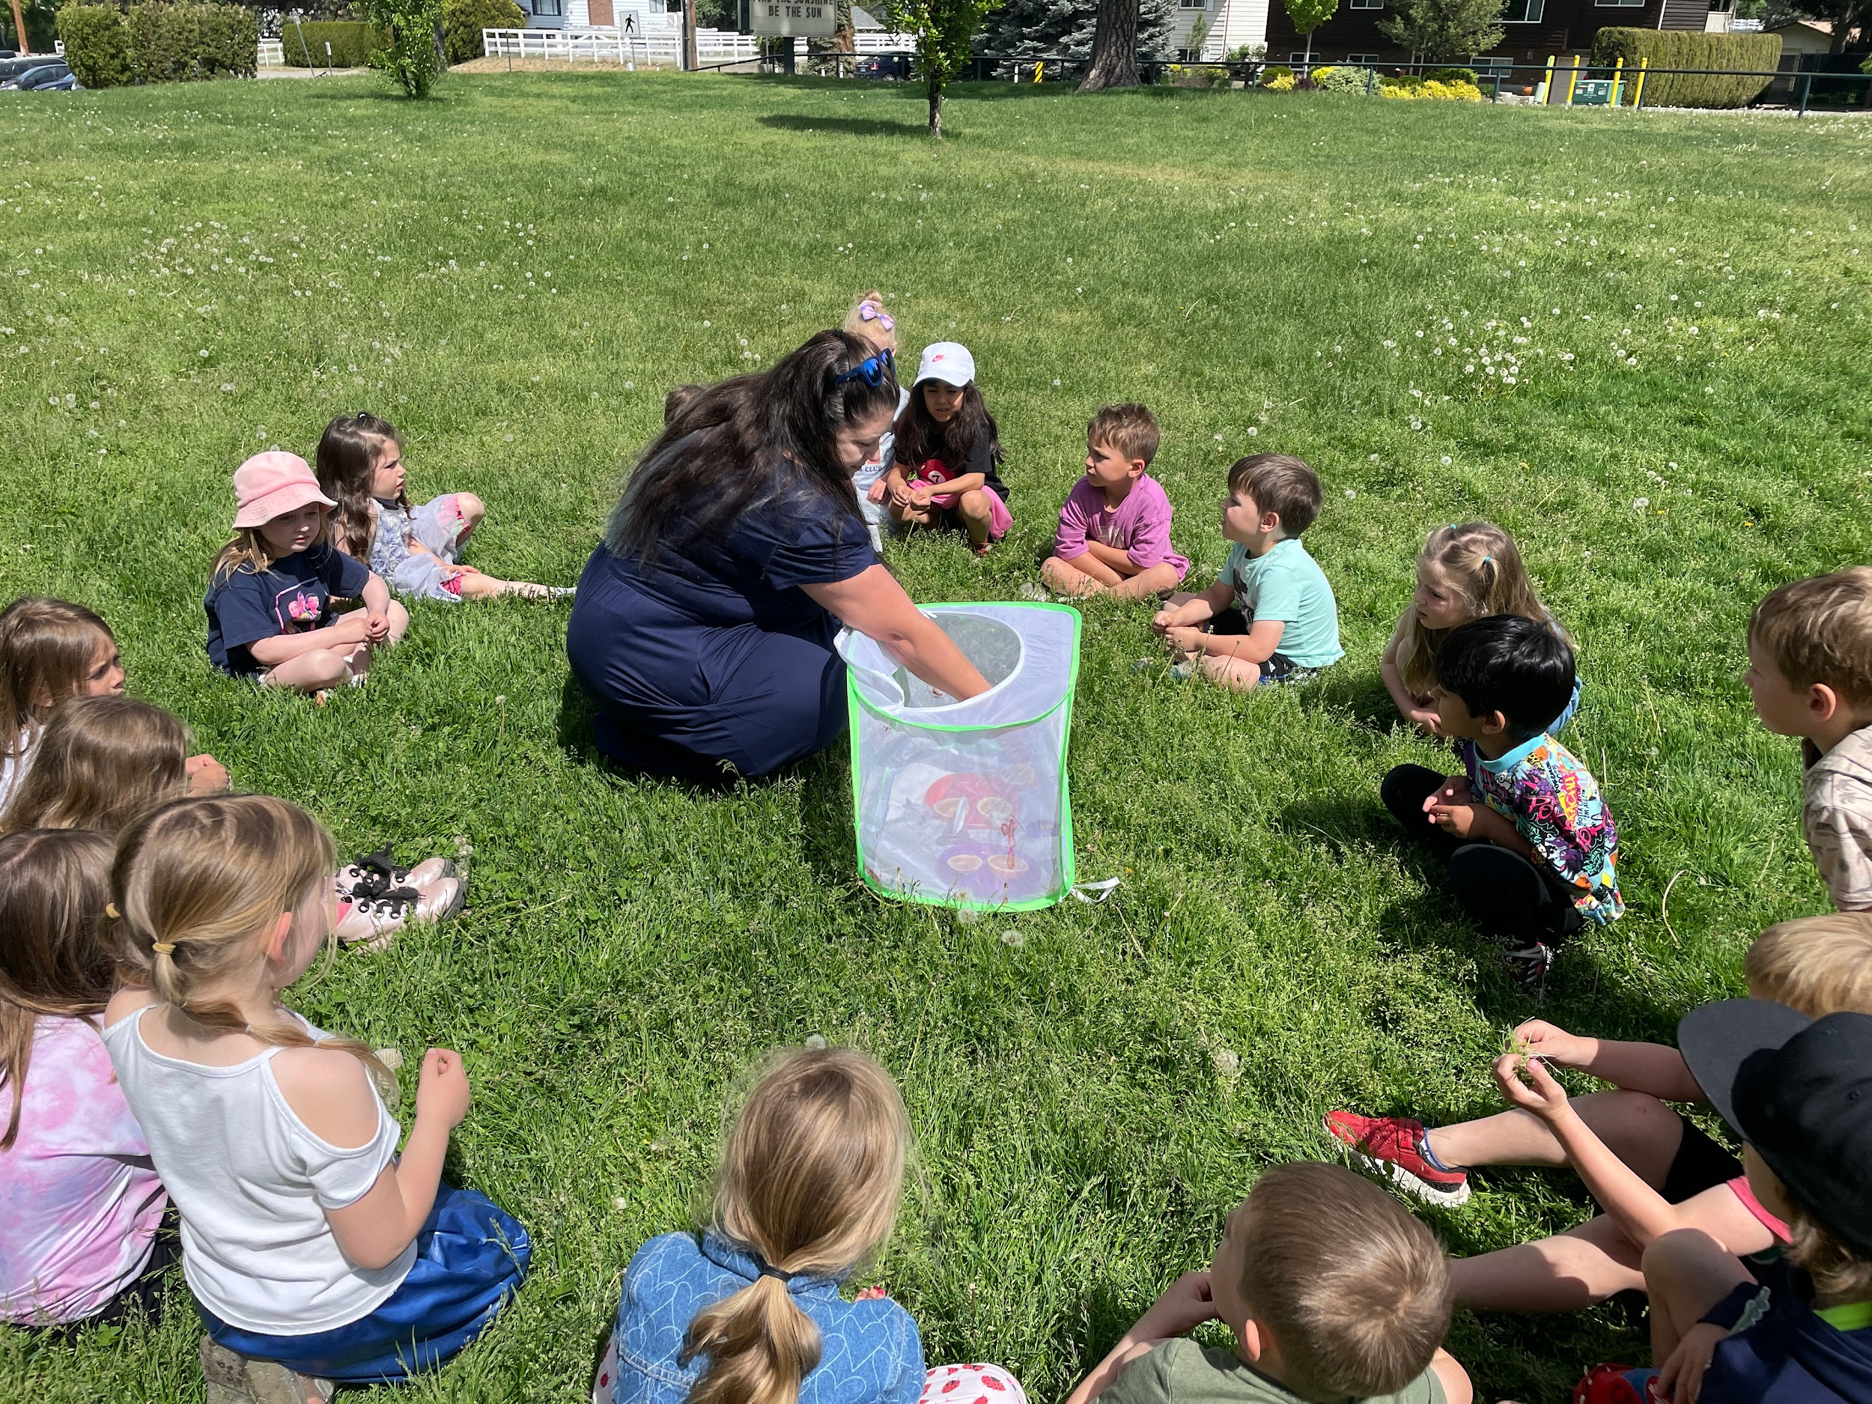
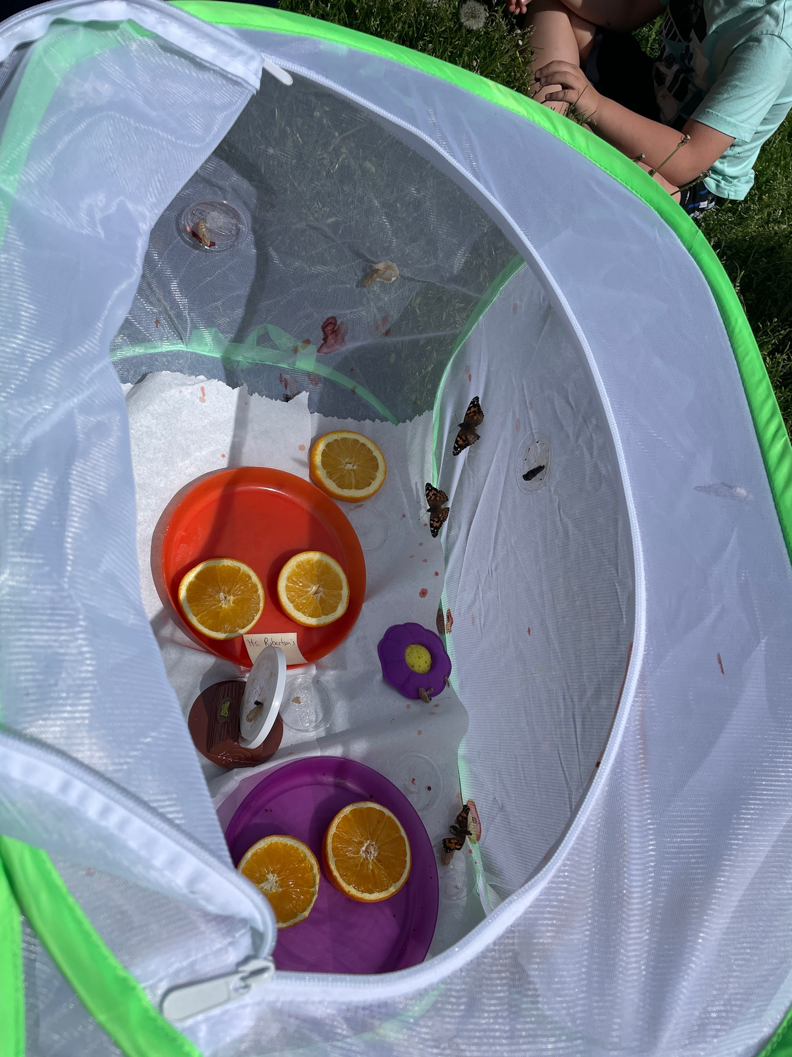
Smiles Before the
Microphone
Collaborative Learning
Cultural Performance
MAY AT
SKE!
Reading
Goals!
Jersey Crew
Kindergarten
Butterflies

Slide 14
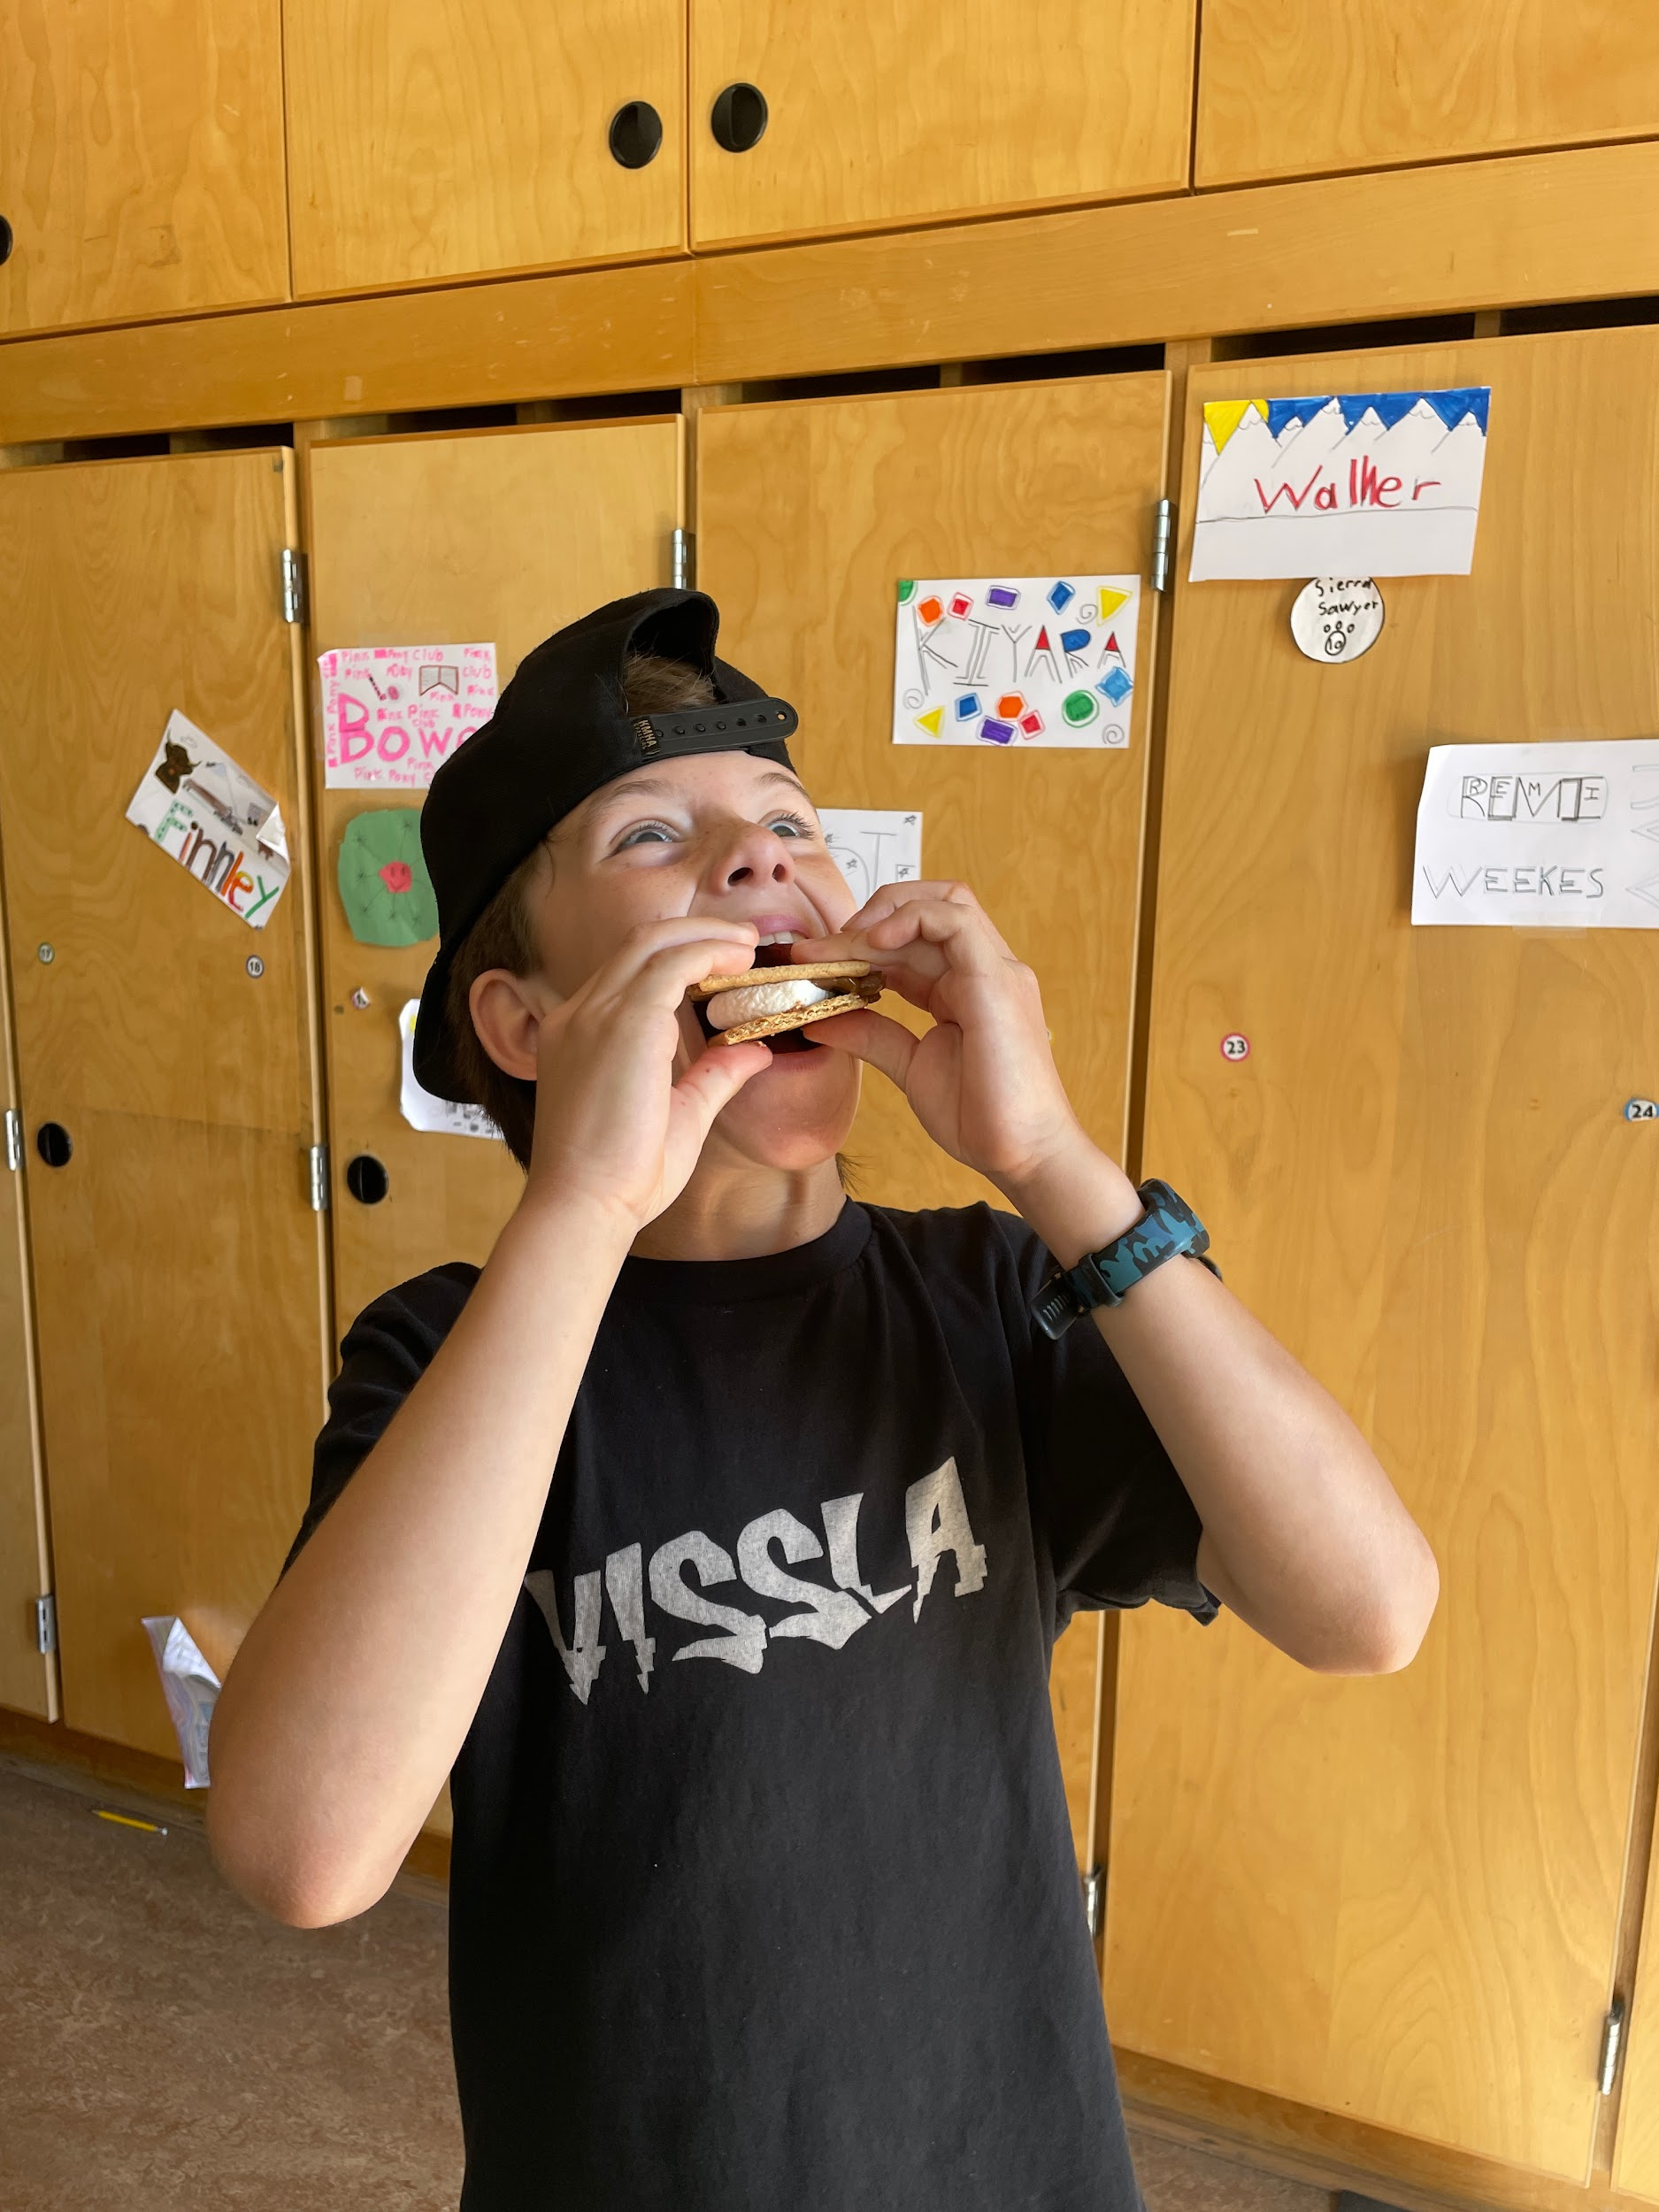
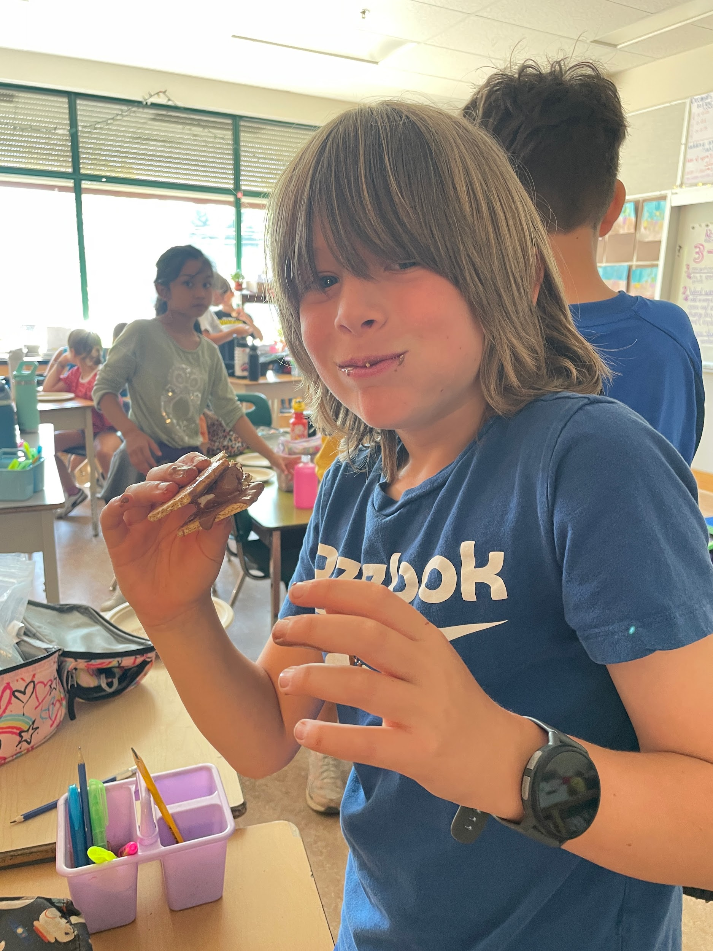
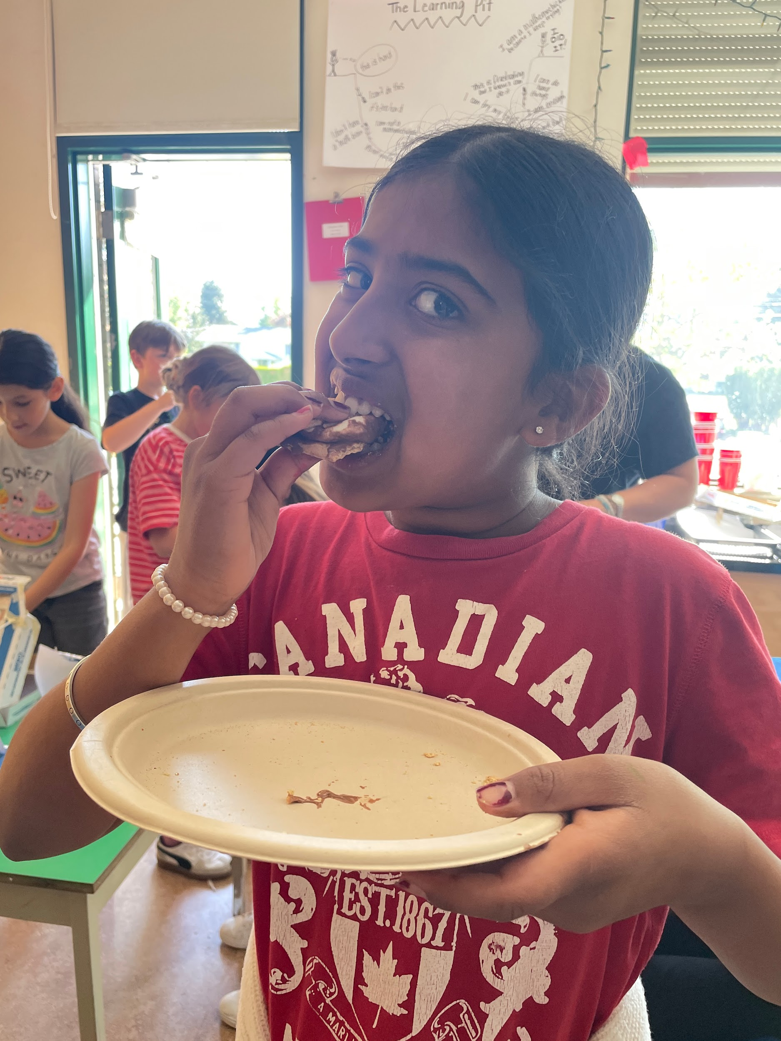
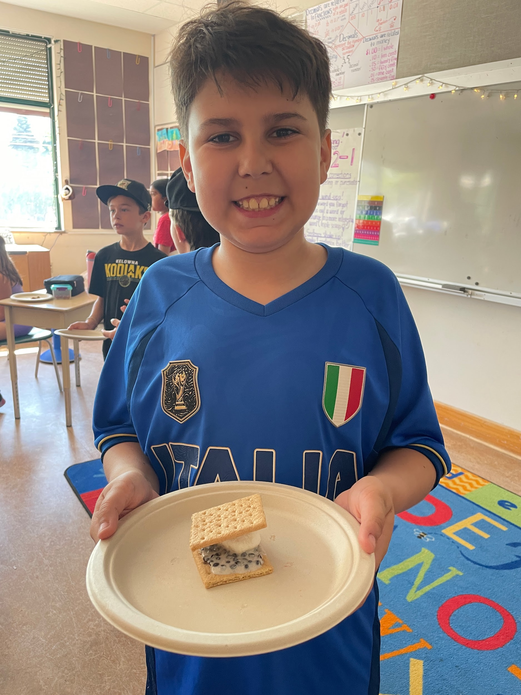
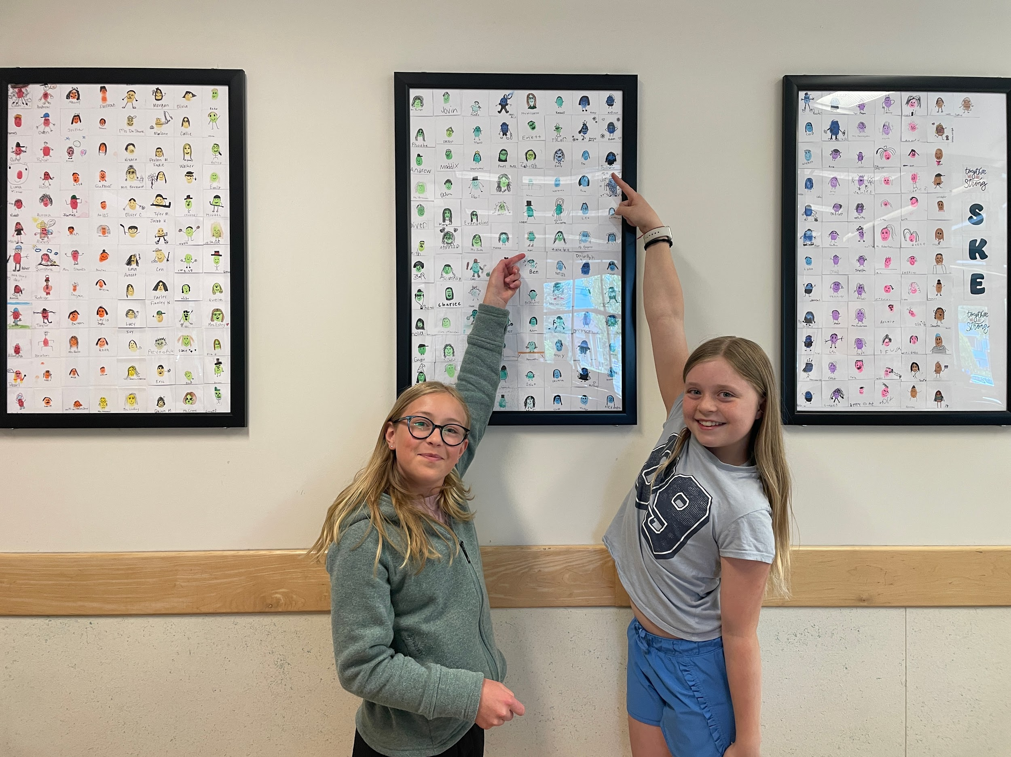
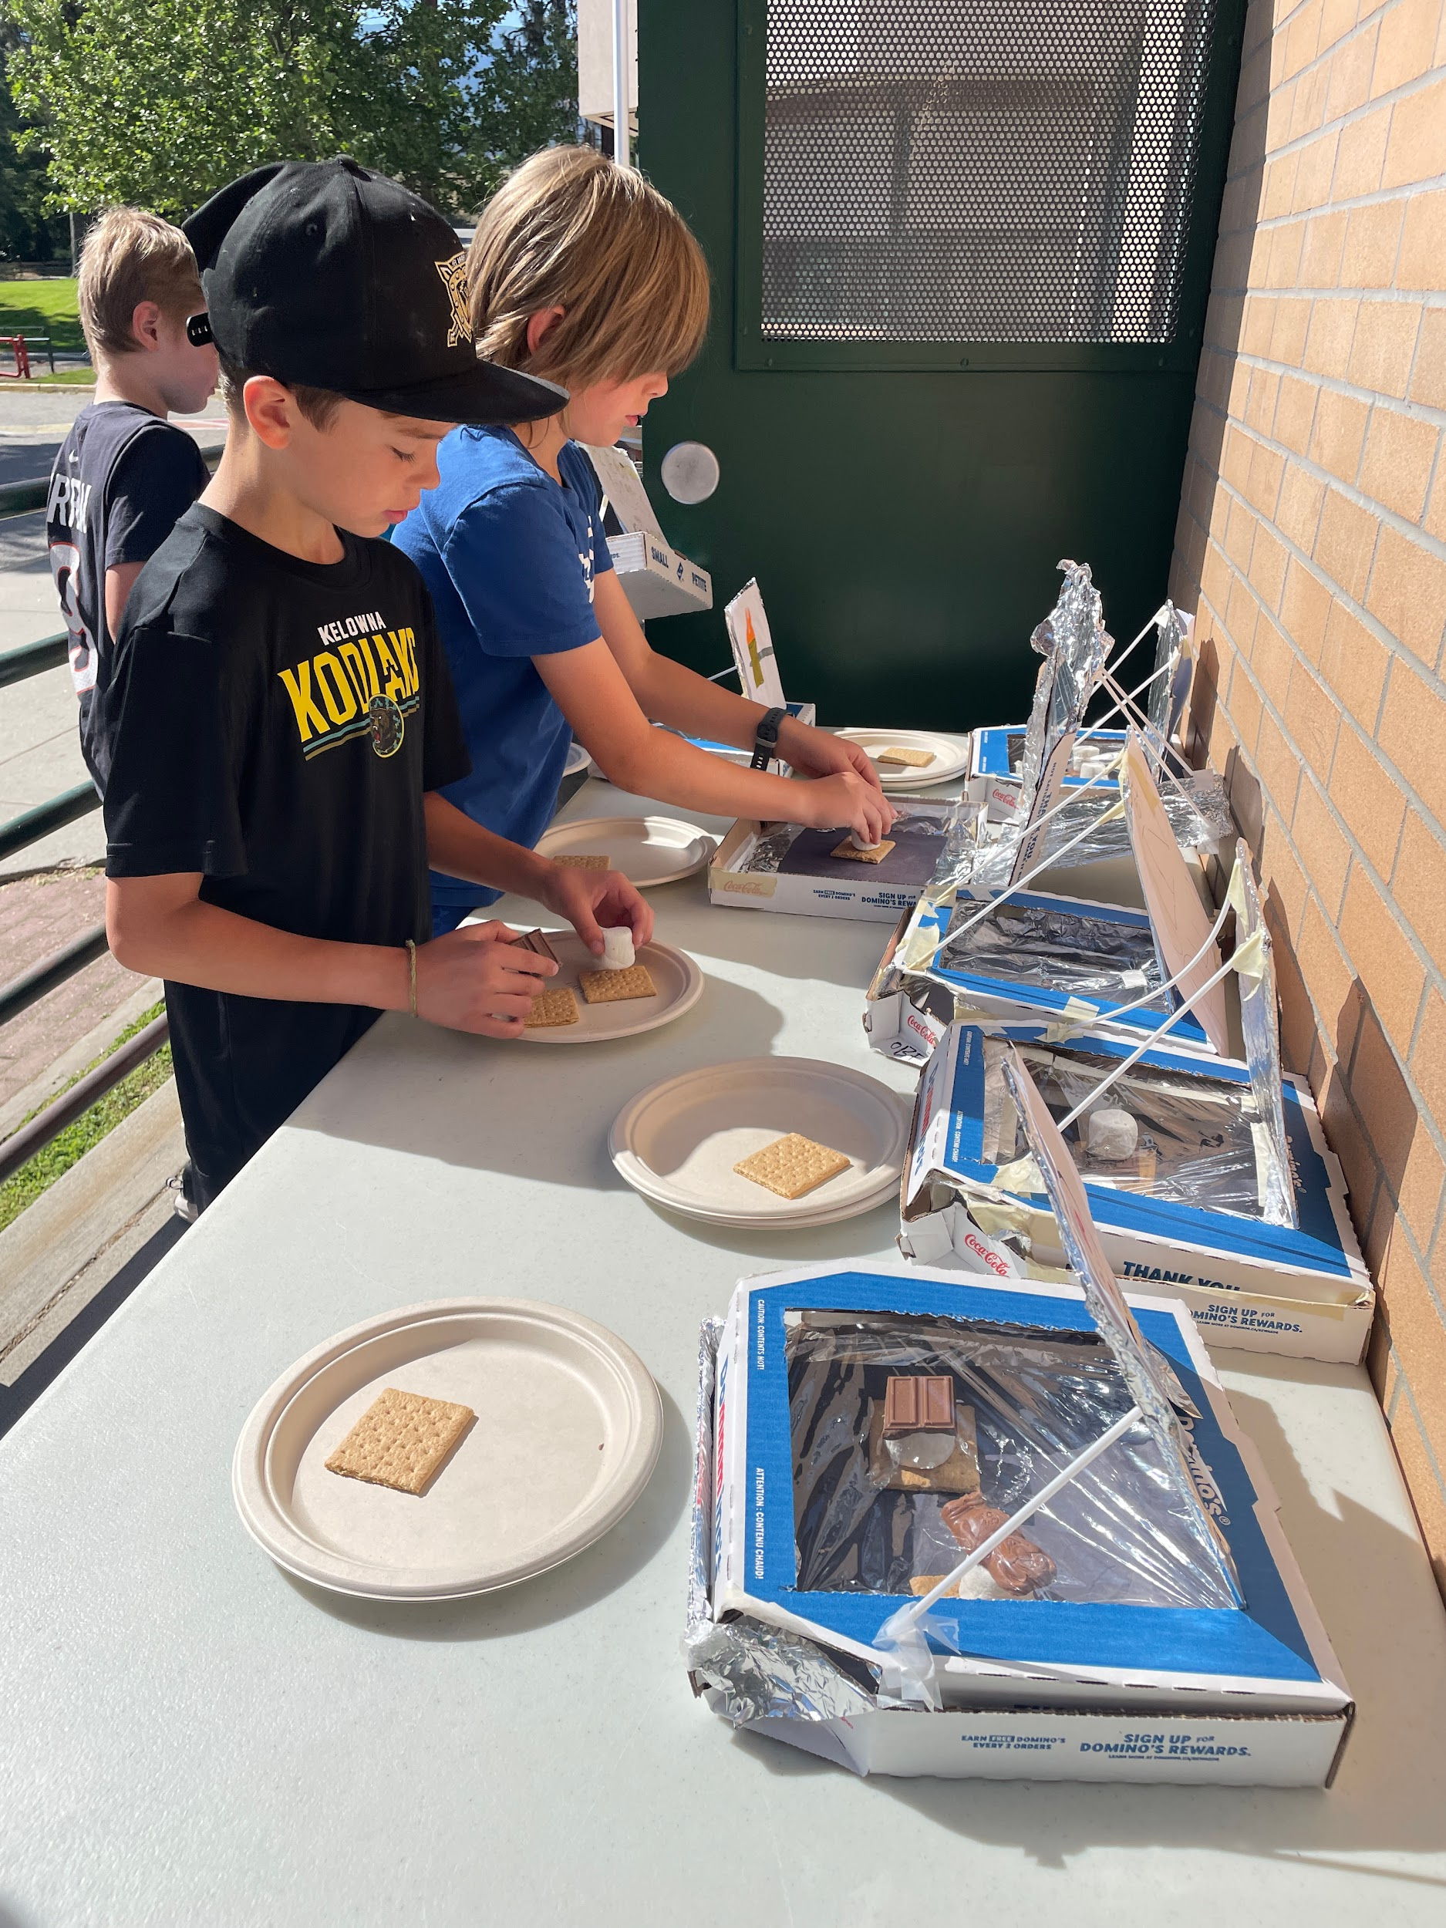
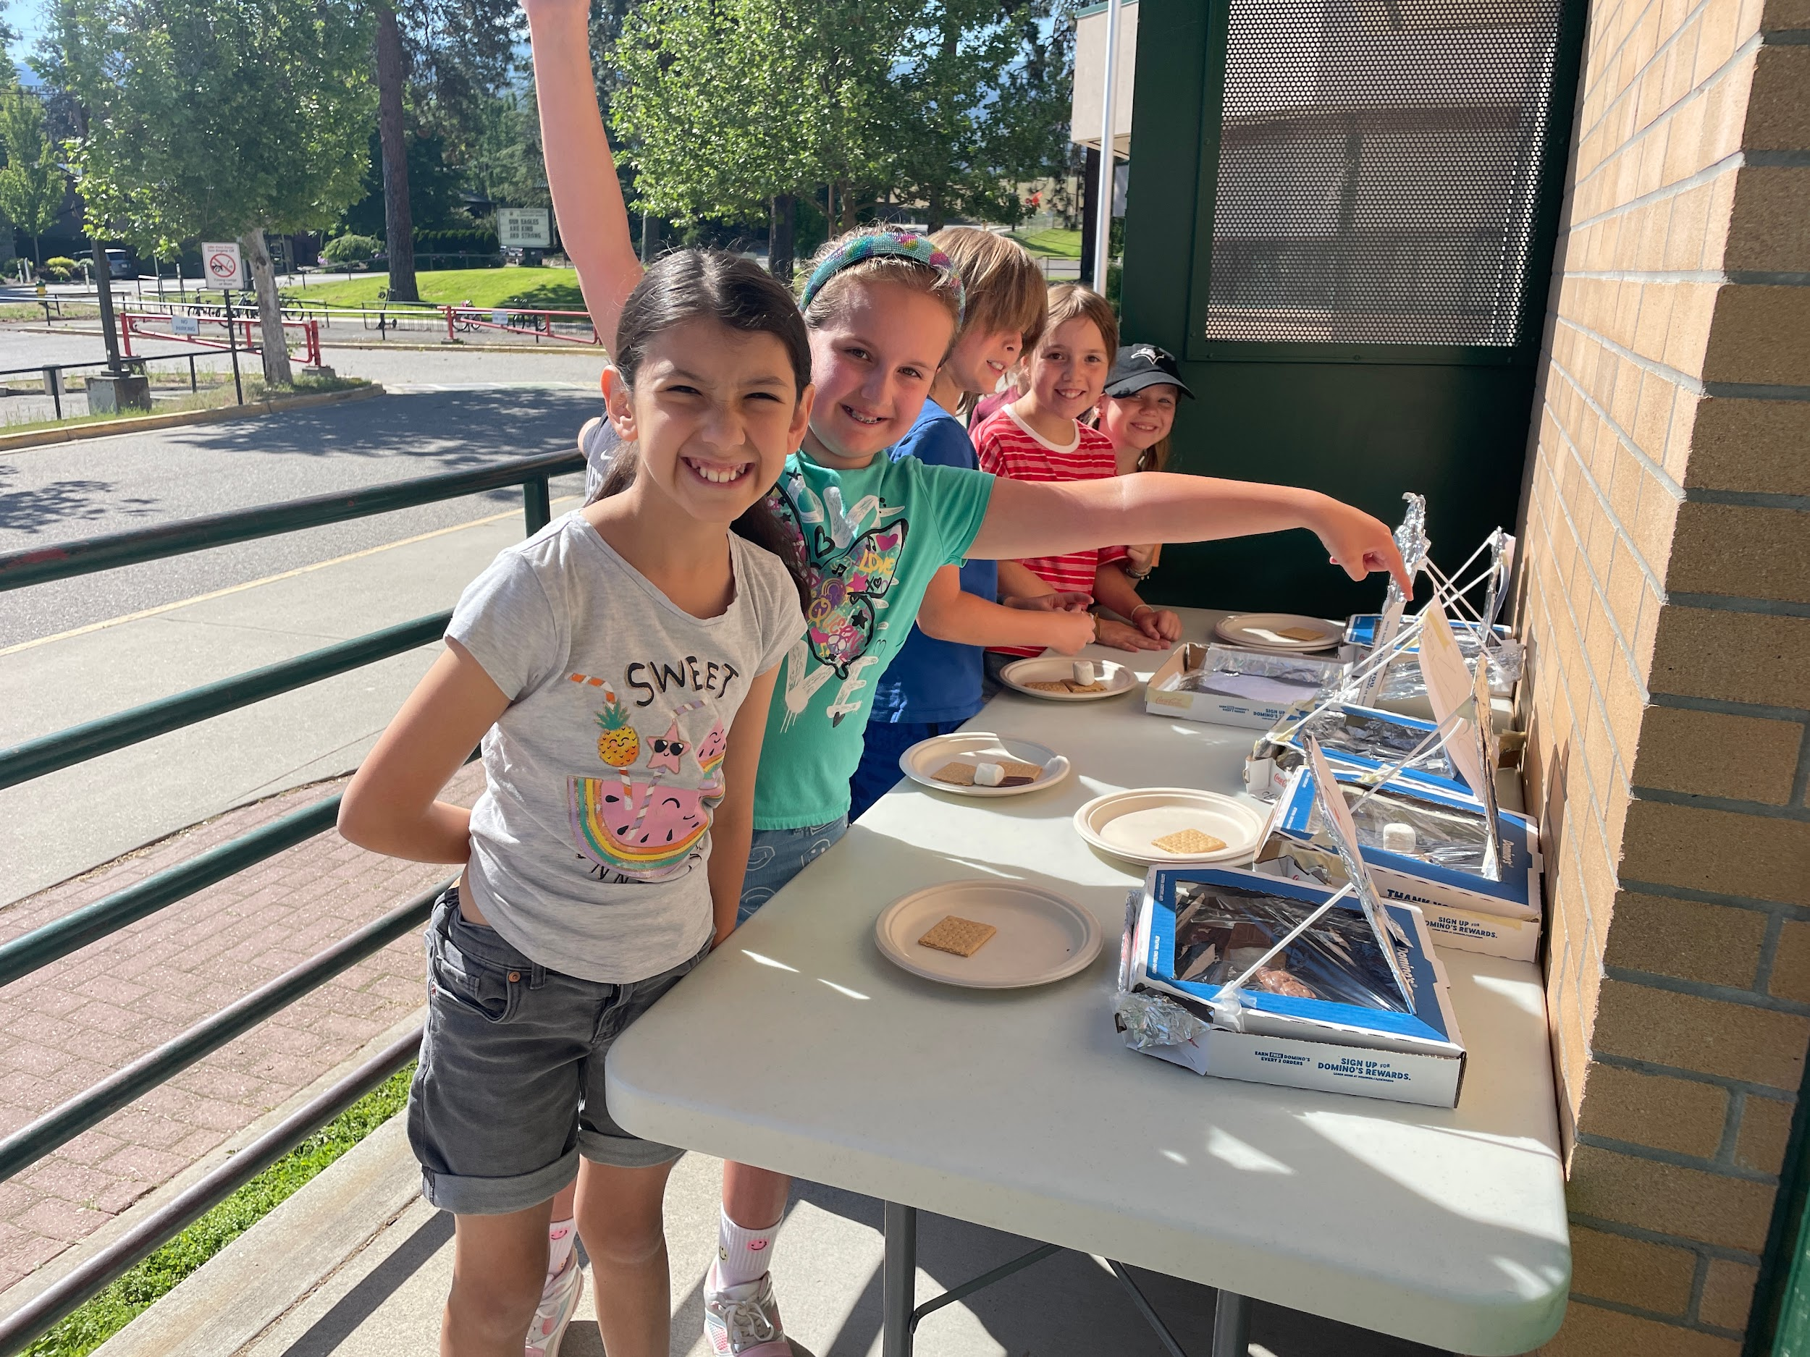
Mrs. Bernard’s class experienced solar energy this week by building pizza-box ovens that use the sun’s rays for heat. They were able to enjoy delicious, scrumptious s’mores and be scientists at the same time!
Check out this new artwork in our front hallway, created with mini thumbprint portraits of every learner and staff member. Big thanks to Kalla & Kinley for helping put the framed art together. Above you’ll see Kalla and Abigail pointing out their personal portraits. Check it out next time you visit.

Slide 15




COMMUNITY NEWS, EVENTS & OPPORTUNITIES

Slide 16



We are looking for families to host international high school
students from around the world.
Next round of placements begins September 2026. Homestay compensation will be $1200/month/student starting in 2026-2027.
Apply now to join our team as a host family for international students experiencing Canada.
CLICK HERE TO LEARN MORE & APPLY

Slide 17
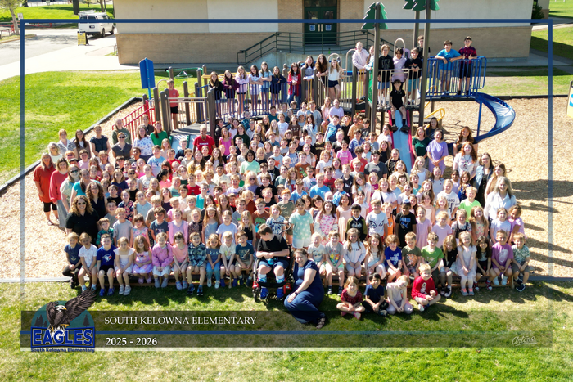
Thank you for reading!
We hope you enjoyed this month’s
edition of The Eagle Gazette.

